Slide 2
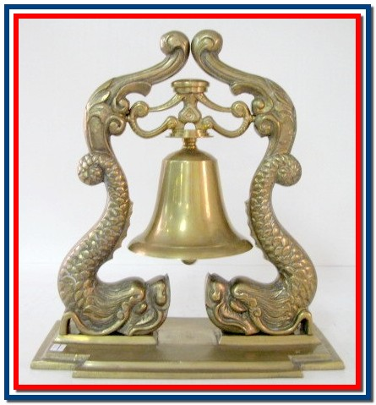
UNITED STATES SUBMARINE VETERANS
TOLLING of the BOATS CEREMONY

Slide 3
“A nation reveals itself not only by the men it produces, but also by the men it honors, the men it remembers.” John F. Kennedy

Slide 4
Our purpose: to perpetuate the memory of our shipmates who gave their lives in the pursuit of their duties while serving their country.

Slide 5
The Brotherhood of Dolphins

Slide 6
BOATS AND MEN LOST PRIOR TO WWII

Slide 7
USS F-4 SKATE (SS-23) Lost with 21 men on 25 March 1915 when she foundered off Honolulu, Hawaii
Notes:
Map 020 025

Slide 8
USS F-1 CARP (SS-20) Lost with 19 men on 17 December 1917 when it was sunk after a collision with the USS F-3 (SS-22) off La Jolla, California

Slide 9
USS H-1 SEAWOLF (SS-28) Lost 12 March 1920 with the loss of 4 men when it grounded off the coast of Santa Margarita Island, Baja California

Slide 10
USS S-5 MOCCASIN (SS-110) Lost 1 September 1920 when it foundered 40 miles offshore of the Delaware Capes. The crew escaped through a hole cut in the hull in the aft tiller room

Slide 11
USS 0-5 (SS-66) Lost 29 October 1923 with 3 men when it sunk after a collision with SS Ababgarez off the Panama Canal. Torpedoman’s Mate 2nd Class Henry Breault received the Medal of Honor

Slide 12
USS S-51 (SS-162) Lost 25 September 1925 with the loss of 33 men when it sunk after a collision with the SS City of Rome off Block Island, Rhode Island

Slide 13
USS S-4 SNAPPER (SS-109) Lost with 40 men on 17 December 1927 after being rammed by USCG Cutter Paulding off Provincetown, Massachusetts

Slide 14
USS S-11 SQUALUS (SS-192) Lost 23 May 1939 with 26 men when flooded off Portsmouth, New Hampshire. Salvaged and re-commissioned as USS Sailfish (SS-192)

Slide 15
USS O-9 (SS-70) Lost 20 June 1941 with 34 men when it foundered off Isle of Shoals, New Hampshire

Slide 16
BOATS AND MEN LOST DURING WWII "I can assure you that they went down fighting and that their brothers who survived them took a grim toll of our savage enemy to avenge their deaths." Vice Admiral Charles A. Lockwood, Jr., USN

Slide 17
USS SEALION (SS-195) Lost with 4 men on 10 December 1941 by aerial bombs during Japanese air attack at Cavite Navy Yard, Republic of the Philippines

Slide 18
USS S-36 (SS-141) Lost 20 January 1942, destroyed after she ran aground on the Taka Bakang Reef in Makassar Straight, Indonesia near Makassar City. The crew was rescued

Slide 19
USS S-26 (SS-131) Lost with 46 men on 24 January 1942 in the Gulf of Panama, West of San Jose Light when USS PC-460 rammed it. Three men survived

Slide 20
USS P-3 SHARK (SS-174) Lost with all hands (59 men) on 11 February 1942 when it was sunk by surface craft east of Menado, Celebes Island as a result of one of three Japanese attacks

Slide 21
USS PERCH (SS-176) Lost 3 March 1942 when sunk by Japanese surface attack 30 miles NW of Surabaya, Java. 59 men taken prisoner, 6 died as P.O.W.’s and 53 survived the war

Slide 22
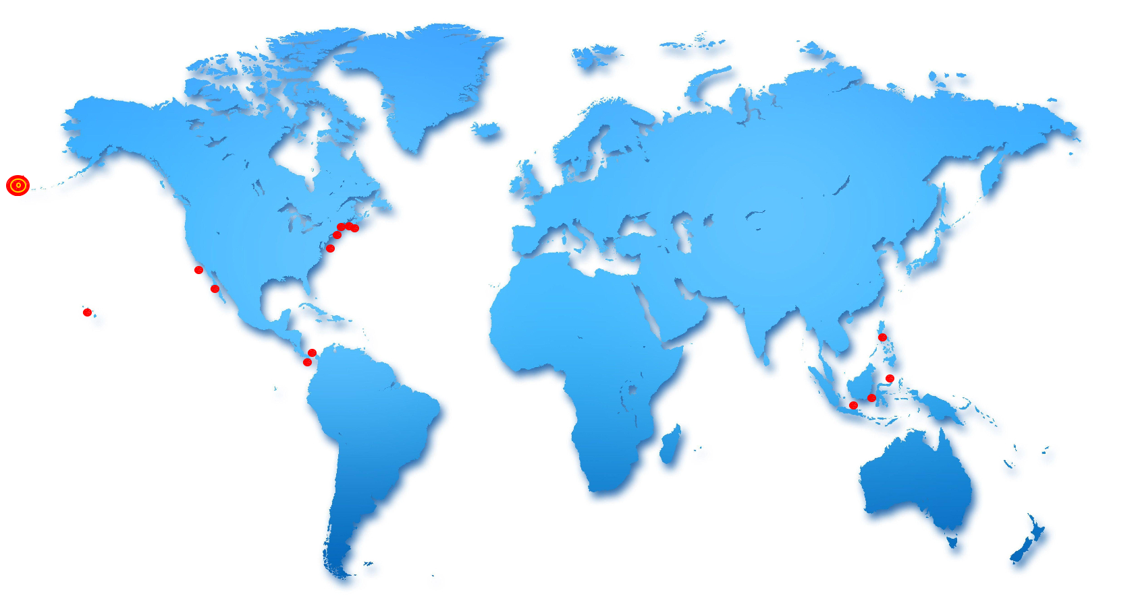
USS S-27 (SS-132) Lost on 19 June 1942 when it grounded off Amchitka Island, 400 yards off the island of St. Makarius Point near Constantine Harbor. The crew was rescued

Slide 23
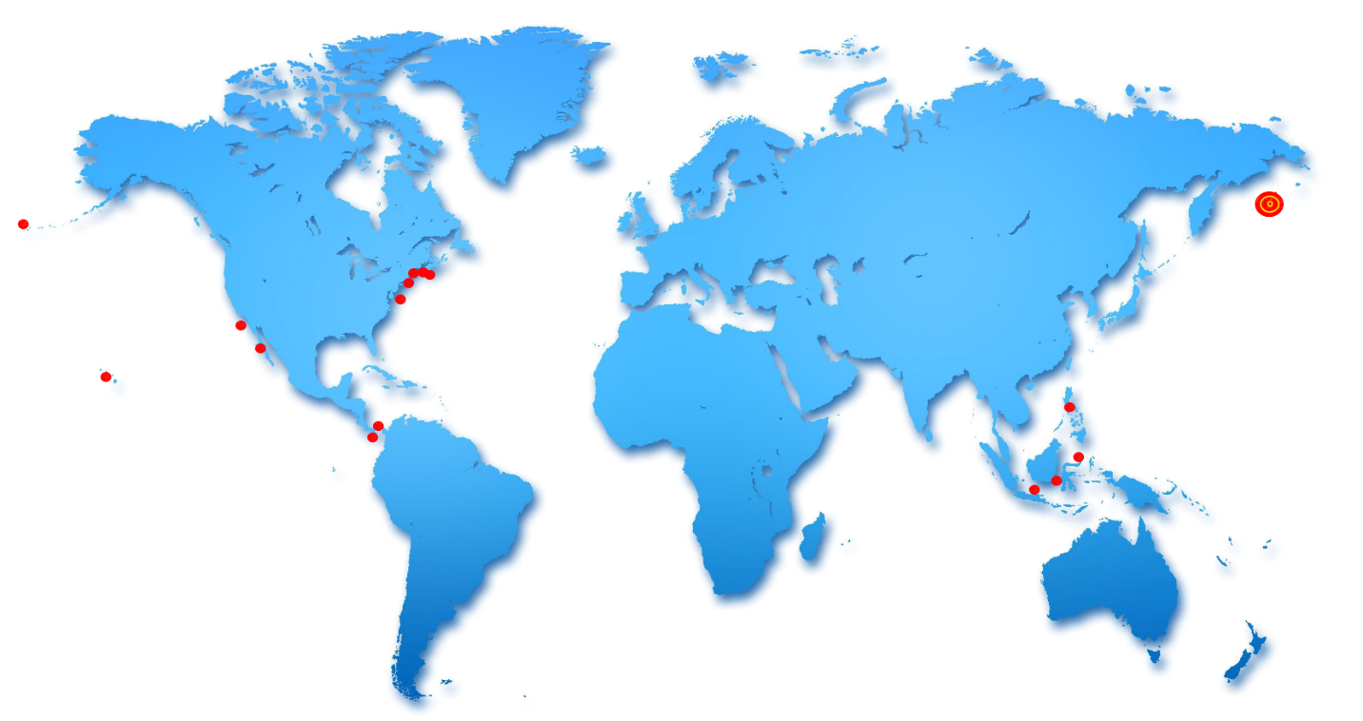
USS GRUNION (SS-216) Lost with 70 men on 30 July 1942 off Kiska Island, Aleutians to naval gunfire

Slide 24
USS S-39 (SS-144) Lost on 14 August 1942 when it was destroyed after grounding on a reef south of Rossel Island, Louisande Archipelago. The crew was rescued

Slide 25
USS V-4 ARGONAUT (SS-166) Lost with all hands (102 men) 10 January 1943 in Java Sea by Japanese surface attack

Slide 26
USS AMBERJACK (SS-219) Lost with all hands (72 men) by Japanese aerial bombs and surface craft on 16 February 1943 off Rabaul in the Solomon Sea

Slide 27
USS GRAMPUS (SS-207) Lost with all hands (71 men) by Japanese surface attack in the Solomon Islands on 5 March 1943

Slide 28
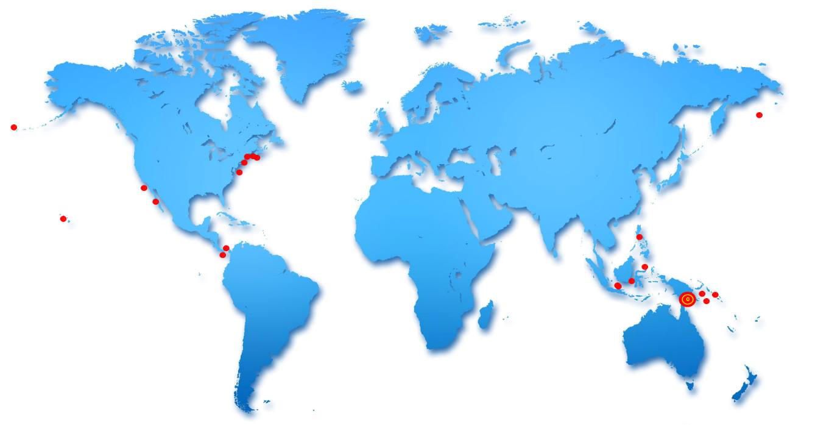
USS TRITON (SS-201) Lost with all hands (74 men) by Japanese surface attack off New Guinea on 15 March 1943

Slide 29
USS PICKEREL (SS-177) Lost with all hands (74 men) by Japanese surface attack off Honshu, Japan on 3 April 1943

Slide 30
USS GRENADIER (SS-210) Lost on 22 April 1943, 10 miles west of Lem Voalan Strait. Sunk by aerial bombs. 76 men taken prisoner, 4 died as POW’s, 72 survived the war

Slide 31
USS R-12 (SS-89) Lost with 42 men off Key West, Florida, on 12 June, 1943 to unknown causes. 5 men survived

Slide 32
USS RUNNER (SS-275) Lost with all hands (78 men) by possible Japanese mine off Honshu, Japan in June 1943

Slide 33
USS GRAYLING (SS-209) Lost with all hands (76 men) after being rammed by a Japanese transport on 9 September 1943 near Tablas Strait, Republic of the Philippines

Slide 34
USS POMPANO (SS-181) Lost with all hands (77 men) by possible Japanese mine off Honshu, Japan on 17 September 1943

Slide 35
USS CISCO (SS-290) Lost will all hands (76 men) on 28 September 1943 during Japanese air and surface attack in the Sulu Sea

Slide 36
USS S-44 (SS-155) Lost 7 October 1943 with the loss of 56 men when it was sunk by surface craft near Ariado Island, Kuriles. 2 men survived and were taken prisoner

Slide 37
USS WAHOO (SS-238) Lost with all hands (80 men) during a Japanese air and surface attack on 11 October 1943 in La Perouse Strait, off Japan

Slide 38
USS DORADO (SS-248) Lost with all hands, (77 men) to unknown causes in SW Atlantic 12 October 1943

Slide 39
USS CORVINA (SS-226) Lost with all hands (82 men) on 16 November 1943 during a Japanese submarine attack off Truk

Slide 40
USS SCULPIN (SS-191) Sunk by a Japanese surface craft on 19 November 1943 north of Goluk near Truk with the loss with of 43 men. 41 men were taken prisoner but only 21 survived the war.

Slide 41
USS CAPELIN (SS-289) Lost with all hands (76 men) on 2 December 1943 by an unconfirmed Japanese surface attack near Celebes Sea

Slide 42
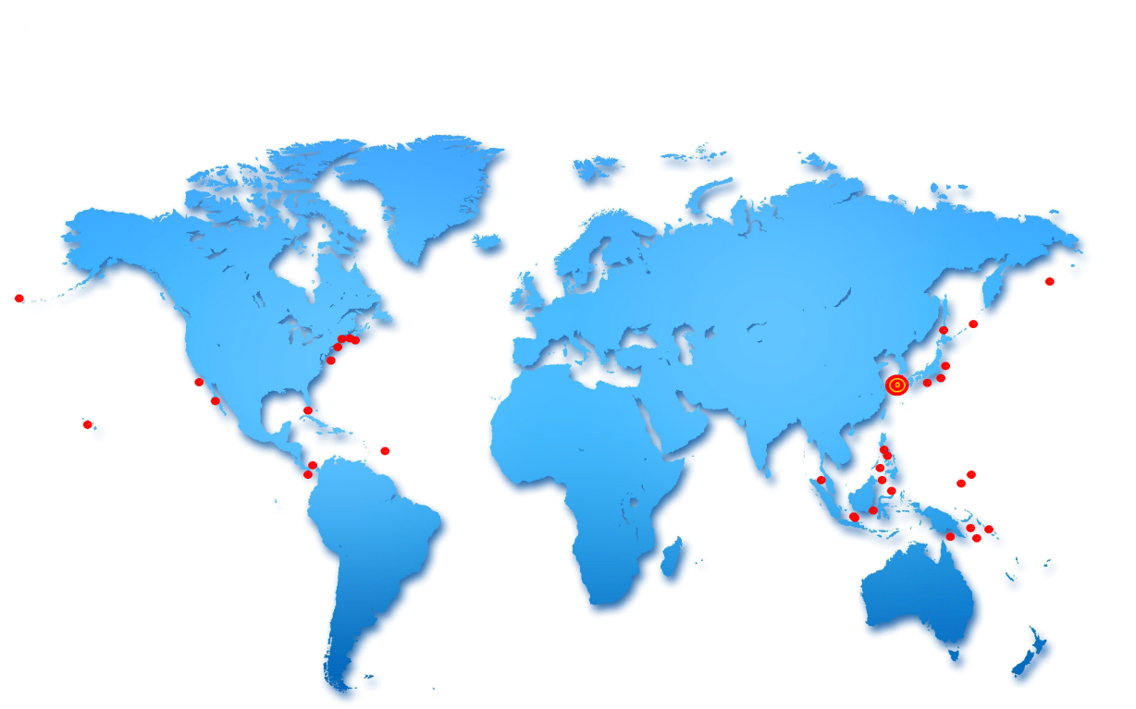
USS SCORPION (SS-278) Lost with all hands (77 men) on 5 January 1944 by possible Japanese mine in the Yellow Sea off Japan

Slide 43
USS GRAYBACK (SS-208) Lost with all hands (80 men) on 26 February 1944 during Japanese air and surface attack in the East China Sea

Slide 44
USS TROUT (SS-202) Lost with all hands (81 men) on 29 February 1944 during a Japanese surface attack in the Philippine Sea

Slide 45
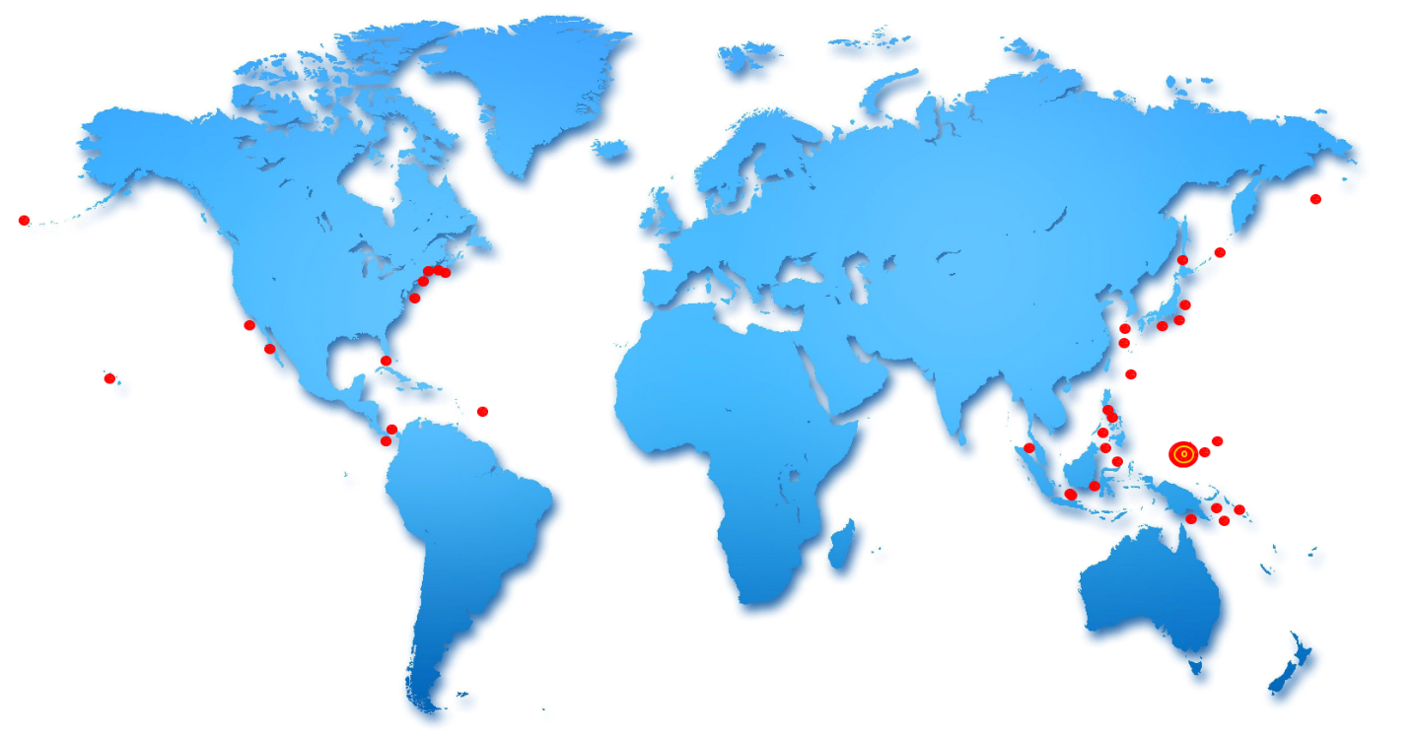
USS TULLIBEE (SS-284) Lost with 79 men on 26 March 1944 north of Palau. Boat was sunk by her own torpedo. One man survived and was taken prisoner

Slide 46
USS GUDGEON (SS-211) Lost with all hands (79 men) during a Japanese air and surface attack on 12 May 1944 in the Northern Marianas

Slide 47
USS HERRING (SS-233) Lost with all hands (83 men) 1 June 1944 by a Japanese shore battery and surface craft off Matsuwa Island, Kuriles

Slide 48
USS GOLET (SS-361) Lost with all hands (82 men) during Japanese surface attack off Honshu, Japan on 14 June 1944

Slide 49
USS S-28 (SS-133) Lost with all hands (49 men) when she foundered off the Hawaiian Islands on 4 July 1944

Slide 50
USS ROBALO (SS-273) Lost with 77 men by possible Japanese mine off Palawan on 26 July 1944. Four men survived but died in captivity

Slide 51
USS FLIER (SS-250) Lost with 78 men on 13 September 1944 when sunk by Japanese mine in the Balabac Strait near Mantangule Island. Eight men survived and were later rescued by the USS Redfin (SS-272)

Slide 52
USS HARDER (SS-257) Lost with all hands (79 men) during a Japanese depth charge attack off Luzon, Republic of the Philippines on 24 August 1944

Slide 53
USS SEAWOLF (SS-197) Lost with all hands (100 men) on 3 October 1944 when it was mistaken for a Japanese submarine and sunk by friendly destroyers just north of Morotai, Indonesia

Slide 54
USS ESCOLAR (SS-294) Lost with all hands (82 men) by possible Japanese mine in the Yellow Sea off China on 17 October 1944

Slide 55
USS DARTER (SS-227) Lost 24 October 1944 when it became grounded on Bombay Shoal off Palawan and was then destroyed. The submarine USS Dace (SS-247) rescued the crew

Slide 56
USS SHARK (SS-314) Lost with all hands (87 men) on 24 October 1944 when it was sunk by Japanese surface craft midway between Hainan and Bashsi Channel

Slide 57
USS TANG (SS-306) Lost with 78 men on 25 October 1944 when it was sunk by her own torpedo in the north end of the Formosa Strait. Nine of the crew were taken prisoner and survived the war. Her Commanding Officer received the Medal of Honor

Slide 58
USS ALBACORE (SS-218) Lost with all hands (85 men) by a possible Japanese mine on 7 November 1944 between Honshu and Hokkaido, Japan

Slide 59
USS GROWLER (SS-215) Lost with all hands (86 men) on 8 November 1944 by a possible Japanese surface attack in the South China Sea

Slide 60
USS SCAMP (SS-277) Lost with all hands (83 men) on 11 November 1944 when she was sunk during a Japanese surface attack in the Tokyo Bay area

Slide 61
USS SWORDFISH (SS-193) Lost with all hands (89 men) by possible Japanese surface attack or mine on 12 January 1945 off Okinawa

Slide 62
USS BARBEL (SS-316) Lost with all hands (81 men) on 4 February 1945 during Japanese air attack off the entrance to the Palawan Passage

Slide 63
USS KETE (SS-369) Lost with all hands (87 men) on 20 March 1945 to unknown causes between Okinawa and Midway

Slide 64
USS TRIGGER (SS-237) Lost with all hands (89 men) in the East China Sea on 28 March 1945 during a Japanese air and surface attack

Slide 65
USS SNOOK (SS-279) Lost with all hands (84 men) on 8 April 1945 due to unknown causes off Formosa

Slide 66
USS LAGARTO (SS-371) Lost with all hands (86 men) on 4 May 1945 in the Gulf of Siam during a Japanese surface attack

Slide 67
USS BONEFISH (SS-223) Lost with all hands (85 men) on 18 June 1945 during Japanese depth charge attack off of Honshu in the Sea of Japan

Slide 68
USS BULLHEAD (SS-332) Lost with all hands (84 men) off the Bali coast by a Japanese air attack on 6 August 1945

Slide 69
"We, who survived WWII and are privileged to join our loved ones at home, salute those gallant officers and men of our submarines who lost their lives in that long struggle. We shall never forget that it was our submarines that held the lines against the enemy while our fleets replaced losses and repaired wounds."
Fleet Admiral Chester Nimitz

Slide 70
BOATS AND MEN LOST POST WWII

Slide 71
USS COCHINO (SS-345) Boat lost and one man lost on 26 August 1949 off the coast of Norway due to a battery explosion and fire. Six men from the submarine USS Tusk (SS-426) were also lost during the rescue

Slide 72
USS STICKLEBACK (SS-415) Lost 30 May 1958 off Hawaii when it sunk while being towed after a collision with the USS Silverstein (DE-534). All the crew were taken off before sinking.

Slide 73
USS THRESHER (SSN-593) Lost with all hands (108 crew members, 17 civilian technicians, and 4 U.S. Naval observers) on 10 April 1963 off the New England coast

Slide 74
USS SCORPION (SSN-589) Lost with all hands (99 men) on 22 May 1968 due to possible battery explosion 400 miles south of the Azores

Slide 77
Finally, we remember all the brave Submariners who died in the course of their duties aboard submarines, some individually and some in groups, but where the submarine itself was not lost

Slide 78
Our purpose: to perpetuate the memory of our shipmates who gave their lives in the pursuit of their duties while serving their country.

Slide 79
Lord God, our power evermore,
Whose arm doth reach the ocean floor;
Dive with our crews beneath the sea,
Traverse the depths protectively.
Oh, hear us when we pray, and keep
Them safe from peril in the deep.

Slide 80
In the beginning,
GOD created Submariners….
then
Submariners created Submarines
and
Submarines created the Brotherhood
Sailors, Rest Your Oars

Slide 82
Attributes and credits
Initial Photos and info was sourced from ALBANY-SARATOGA BASE UNITED STATES SUBMARINE VETERANS PowerPoint dated May 1, 2006
Maps, locations, research and reorganization by Buck Crouch, Tucson Base USSVI August 26, 2023

