Slide 1

TOLLING
FOR THE
BOATS
OCTOBER

Slide 2
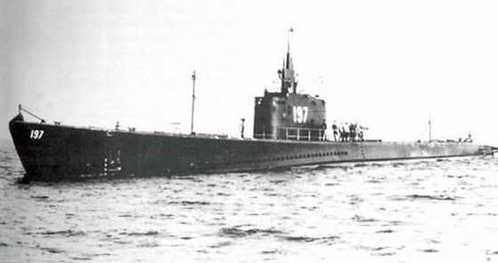
USS SEAWOLF (SS-197)
Notes:
USS SEAWOLF (SS-197) stood out of Brisbane on 21 September 1944 to begin her 15th war patrol. She reached Manus Island on 29 September, refueled, and sailed the same day carrying stores and 17 Army personnel to the east coast of Samar. SEAWOLF and USS NARWHAL exchanged radar recognition signals at 0756 on 3 October in the Morotai area. Shortly thereafter, a 7th Fleet task group was attacked by RO-41. USS SHELTON was torpedoed and sunk, and USS RICHARD M. ROWELL began to search for the enemy. Since there were four friendly submarines in the vicinity of this attack, they were directed to give their positions and the other three did, but SEAWOLF was not heard from. On 4 October, SEAWOLF again was directed to report her position, and again she failed to do so. 100 men lost. (Bell & slide)

Slide 3
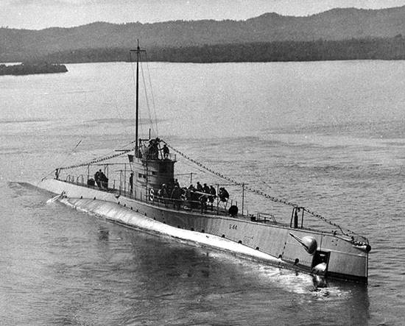
USS S-44 (SS-155)
Notes:
On the night of 7 October, 1943, USS S-44 (SS-155) made radar contact with what she thought was a "small merchantman" and closed in for a surface attack. Several hundred yards from the target, her deck gun fired and was answered by a salvo. The "small merchantman" in fact was the Shimushu-class escort ISHIGAKI. She then took several hits in the control room, the forward battery room, and elsewhere. Reluctantly, S-44 was ordered abandoned. A pillow case was raised from the forward battery room hatch as a flag of surrender, but the Japanese shelling continued. Only two men escaped the sinking ship. 56 men lost. (Bell & slide)

Slide 4
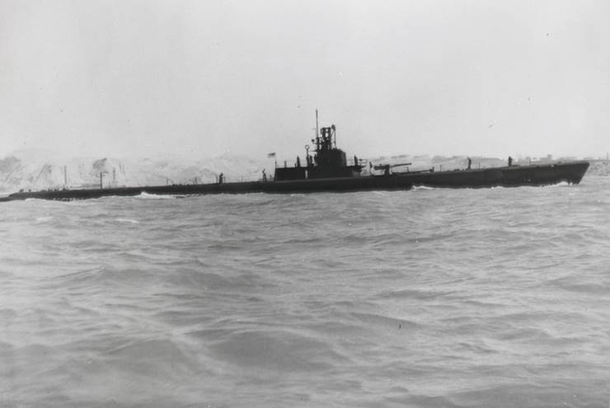
USS WAHOO (SS-238)
Notes:
USS WAHOO (SS-238) got underway from Pearl Harbor, topped off fuel and supplies at Midway on 13 September 1943. The plan was to enter the Sea of Japan, on or about 20 September, with USS SAWFISH following by a few days. At sunset on 21 October, WAHOO was supposed to leave her assigned area, south of the 43rd parallel, and head for home. She was instructed to report by radio after she passed through the Kurils. Nothing further was ever heard from WAHOO. 80 men lost. (Bell & slide)

Slide 5
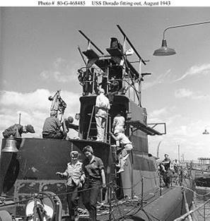
USS DORADO (SS-248)
Notes:
After sea trials, USS DORADO (SS-248) sailed from New London, Connecticut, on 6 October 1943 for the Panama Canal Zone. She did not arrive. Probable cause was a sinking by friendly aircraft thinking her a German U-boat. 77 Men Lost. (Bell & slide)

Slide 6
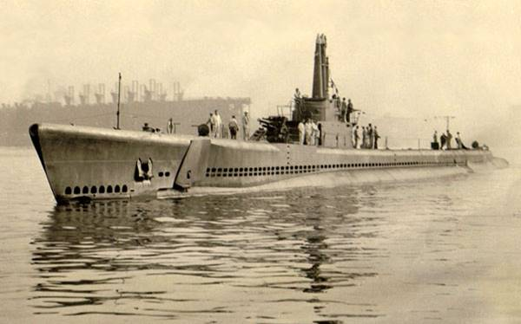
USS ESCOLAR SS-294
Notes:
USS ESCOLAR SS-294 put out for her first war patrol on 18 September 1944. After topping off fuel at Midway Island, she joined USS CROAKER and USS PERCH for a coordinated wolf pack patrol in the Yellow Sea. PERCH and CROAKER recorded intra-ship communications with her until 17 October, when PERCH received a routine message from ESCOLAR giving her position and course. She was never heard from again. Her course as transmitted to PERCH did not cross any known Japanese mine fields, but positions of mines laid before April 1945 are not precisely known. However, the most likely explanation for her end remains that she detonated a mine. 82 men lost. (Bell & slide)

Slide 7
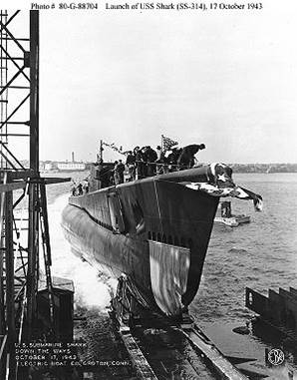
USS SHARK (SS-314)
Notes:
USS SHARK (SS-314) was lost during her third war patrol, probably in the vicinity of Luzon Strait, while participating in a coordinated attack group with US submarines SEADRAGON (SS-194) and BLACKFISH (SS-221). On 24 October, SEADRAGON received a message from SHARK stating that she had made radar contact with a single freighter, and she was going in to attack. This was the last message received from the submarine. 87 men lost. (Bell & slide)

Slide 8
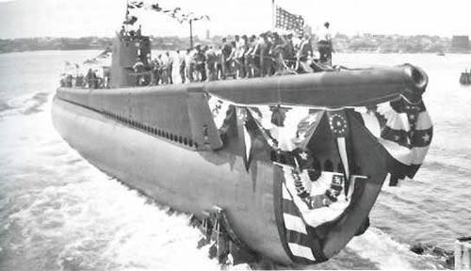
USS DARTER (SS-227)
Notes:
On 21 October USS DARTER (SS-227) headed with DACE for Balabac Strait to watch for Japanese shipping moving to reinforce the Philippines or attack the landing forces. On 23 October, she made contact with the Japanese Center Force approaching Palawan Passage. Immediately, DARTER flashed the contact report, one of the most important of the war, since the location of this Japanese task force had been unknown for some days. She closed in on the task force, and with attacks on the cruisers of Center Force, initiated the Battle of the Surigao Strait phase of the decisive Battle for Leyte Gulf. Just after midnight of 24–25 October DARTER grounded on Bombay Shoal. All confidential papers and equipment were destroyed, and the entire crew taken off. No men lost. (Bell & slide)

Slide 9
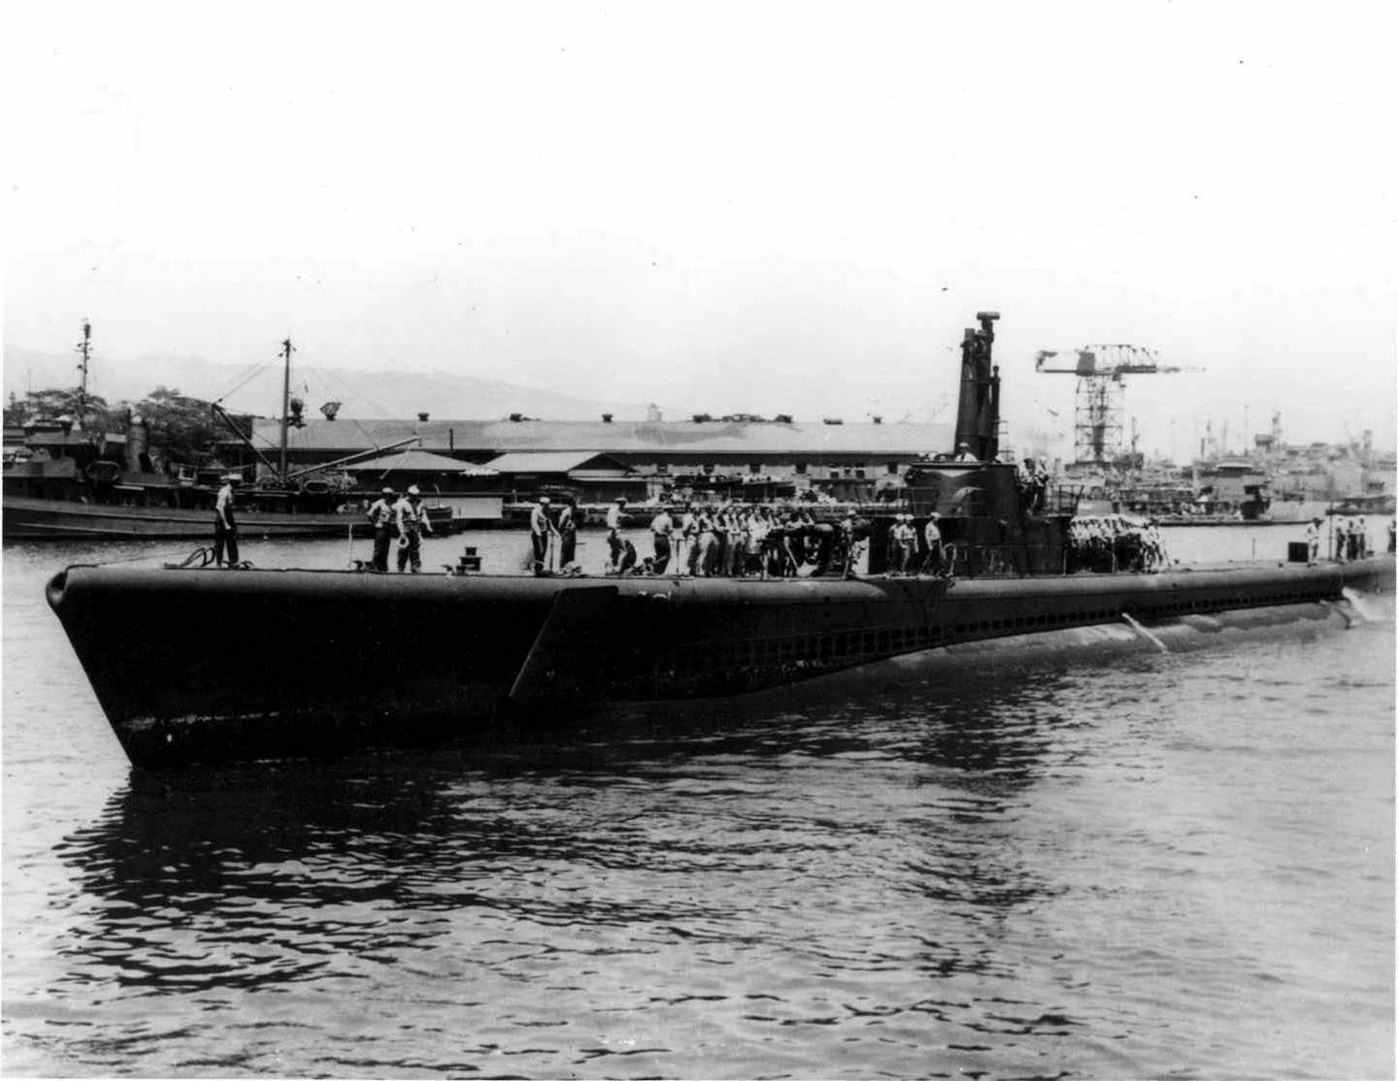
USS TANG (SS-306)
Notes:
USS TANG (SS-306) stood out of Pearl Harbor on 22 January 1944, to begin her first war patrol in the Caroline Islands-Mariana Islands area. In her short career, the TANG sank 31 ships displacing 227,800 tons, a record unequaled by any American submarine before or since. TANG was sunk during the last engagement by a circular run of her final torpedo. The submarine came to rest on the bottom at 180 feet (55 m) and the men within crowded forward as the aft compartments flooded. Publications were burned, and all assembled to the forward room to escape. Of the 13 men who escaped, only nine reached the surface, and of these, five were able to swim until rescued. 78 men lost. (Bell & slide)

Slide 10
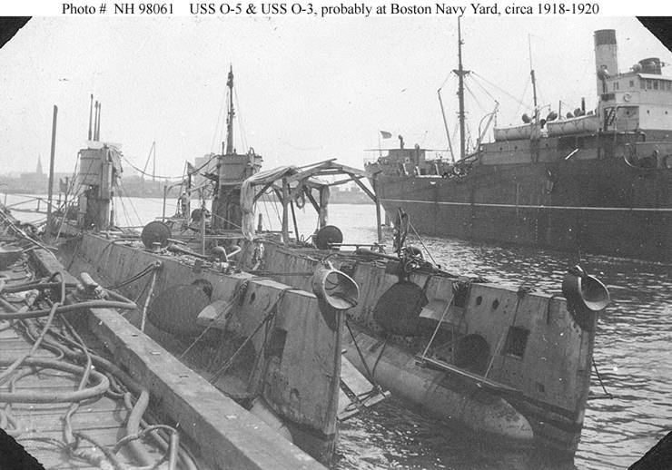
USS O-5 (SS-66) (left)
Notes:
On 28 October 1923, as USS O-5 (SS-66) entered Limon Bay, preparatory to transiting the Panama Canal, she was rammed by the United Fruit Company steamer ABANGAREZ and sank in less than a minute. Three men died; 16 others escaped. Two crewmembers, Henry Breault and Lawrence Brown were trapped in the forward torpedo room, which they sealed against the flooding of the submarine. Local engineers and divers were able to rig cranes and other equipment and lift O-5 far enough off the bottom that the bow broke the surface, exposing a hatch which led to the compartment where the two men were trapped, allowing them to be freed. 3 men lost. (Bell & slide)

Slide 11
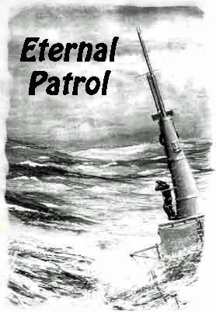
Notes:
And we should remember those sub sailors whose boats may have survived but who themselves departed on Eternal Patrol. Sailors, rest your oars. (Bell)

