Slide 1

TOLLING
FOR THE
BOATS
SEPTEMBER

Slide 2
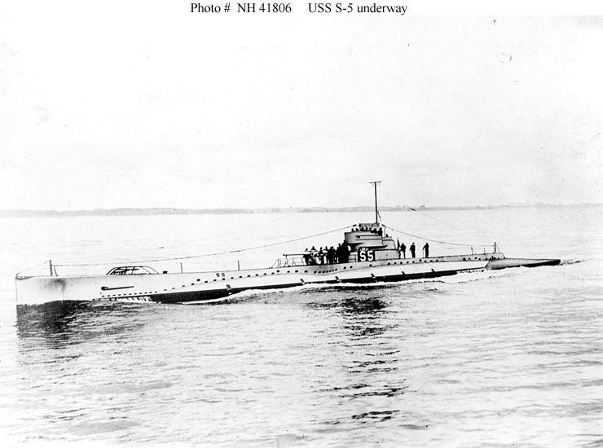
USS S-5 (SS-110)
Notes:
USS S-5 (SS-110) was a S-class submarine of the United States Navy. In September 1920, off the Delaware Capes, a 5 inch pipe burst in the forward torpedo room sinking the boat.
After blowing tanks to raise her stern out of the water, the crew, using hand tools, laboriously cut a 4 inch hole in the pressure hull above the water. The skipper waved a shirt on a pole through the hole to attract a passing ship; that ship enlarged the hole in the hull permitting the crew to escape. When the official salvage team arrived and attempted to lift and tow the submarine to shallower water, the cables snapped and she was lost forever. (Bell & slide)

Slide 3
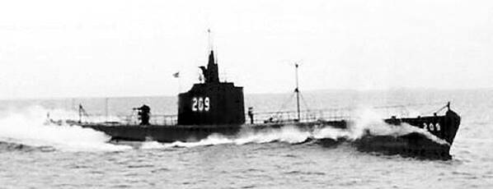
USS GRAYLING (SS-209)
Notes:
USS GRAYLING (SS-209) began her eighth and last war patrol in July 1943 from Fremantle. Cruising in the Philippines area, GRAYLING recorded her last kill, the passenger-cargo MEIZAN MARU on 27 August in the Tablas Strait, but was not heard from again after 9 September. She was scheduled to make a radio report on 12 September, which she did not, and all attempts to contact her failed. GRAYLING was officially reported "lost with all hands" 30 September 1943. 76 Men lost. (Bell & slide)

Slide 4
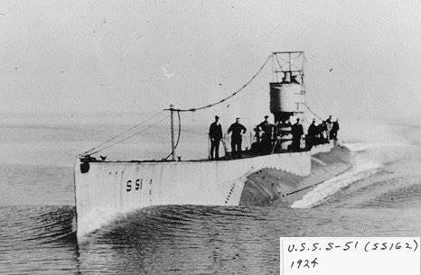
USS S-51 (SS-162)
Notes:
On the night of 25 September 1925, S-51 (SS-162) was operating on the surface near Block Island with her running lights on. The merchant steamer CITY OF ROME spotted the submarine's red sidelight and realized that they were on collision courses. She shifted her rudder and backed her engines, but it was too late. Twenty-two minutes after first spotting the submarine's masthead light, the steamer rammed her at the position she was in. Only three of the 36 men in the submarine were able to abandon ship before she sank. 33 Men Lost. (Bell & slide)

Slide 5
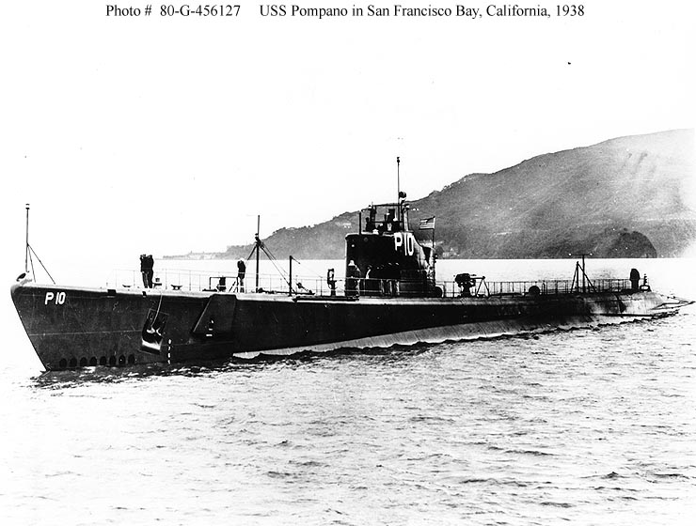
USS POMPANO (SS-181)
Notes:
USS POMPANO (SS-181) was sunk (between Sept 17 and Oct 5) with the loss of 77 men while on her 7th war patrol. Possibly lost on Sept 17, 1943. Japanese records show that a submarine was sunk in her patrol area on 17 September by air & depth charge attack off the Aomori Prefecture near Shiriya Zaki. Before being lost, she sank two enemy cargo ships. The exact cause of her loss remains unknown, but she probably was sunk by the air/sea attack above or fell victim to a mine on or after 9/25/1943. This boat's last recorded ship (TAIKO MARU) sunk happened on Sept 25th, so she probably hit a mine on or after that date but before Oct 5th, when she was scheduled back at Midway. (Bell & slide)

Slide 6
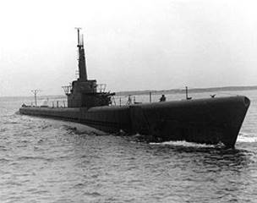
USS CISCO (SS-290)
Notes:
USS CISCO (SS-290) put out from Brisbane, Australia on her first war patrol 20 September, but never returned. Japanese records tell of sighting a submarine leaking oil on 28 September in an area where CISCO is known to have been the only submarine then operating. Japanese records state this submarine was sunk by bombs and depth charges. CISCO is thus presumed to have been lost in action 28 September 1943. 76 Men Lost. (Bell & slide)

Slide 7
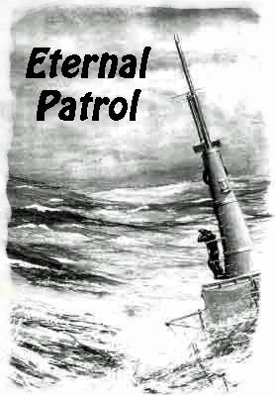
Notes:
And we should remember those sub sailors whose boats may have survived but who themselves departed on Eternal Patrol. Sailors, rest your oars. (Bell)

