Slide 1

TOLLING
FOR THE
BOATS
AUGUST

Slide 2
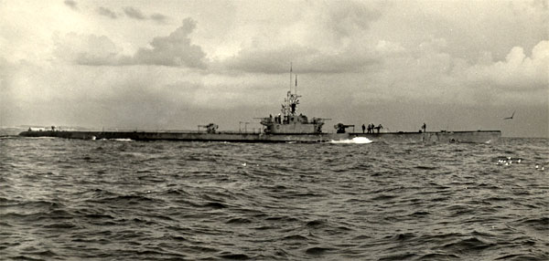
USS BULLHEAD (SS-332)
Notes:
USS Bullhead (SS-332) was lost on August 6, 1945 with 84 crew members in the Lombok Strait while on her 3rd war patrol. She sank from a depth charge dropped by a Japanese Army aircraft. BULLHEAD was the last submarine lost during WWII. (Bell & slide)

Slide 3
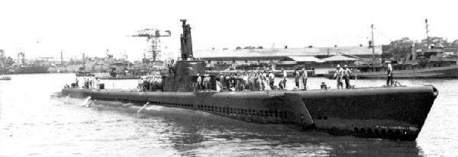
USS FLIER (SS-250)
Notes:
The USS FLIER (SS-250) was lost on August 13, 1944, with 78 crew members while on her 2nd war patrol. FLIER was transiting on the surface when she was rocked by a massive explosion (probably a mine) and sank within less than a minute. 13 survivors, some injured, made it into the water and swam to shore. 8 survived and 6 days later friendly natives guided them to a Coast Watcher and they were evacuated by the USS REDFIN (SS-272). (Bell & slide)

Slide 4
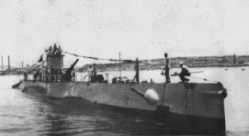
USS S-39 (SS-144)
Notes:
Lost on August 13, 1942 after grounding on a reef south of Rossel Island while on her 3rd war patrol. USS S-39’s entire crew was able to get off and was rescued by the HMAS KATOOMBA. (Bell & slide)

Slide 5
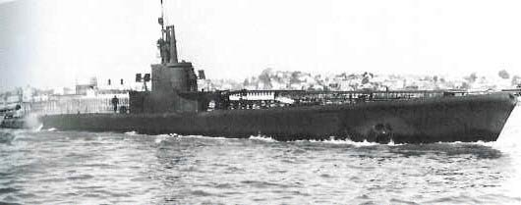
USS HARDER (SS-257)
Notes:
USS HARDER (SS-257) was lost on August 24, 1944 with 79 crew members from a depth charge attack by a minesweeper near Bataan while on her 6th war patrol. HARDER had won a Presidential Unit Citation for her first 5 war patrols and CDR Dealey was awarded the Congressional Medal of Honor posthumously. HARDER is tied for 9th in the number of enemy ships sunk. (Bell & slide)

Slide 6
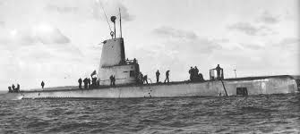
USS COCHINO (SS-345)
Notes:
USS COCHINO (SS-345) was lost on August 26, 1949 after a jolt by a violent polar gale off Norway caused an electrical fire and battery explosion that generated hydrogen and chlorine gasses. In extremely bad weather, men of COCHINO and TUSK (SS-426) fought to save the submarine for 14 hours. After a 2nd battery explosion, Abandon ship was ordered and COCHINO sank. Tusk's crew rescued all of COCHINO's men except for one civilian engineer. Six sailors from TUSK were lost during the rescue. (Bell & slide)

Slide 7
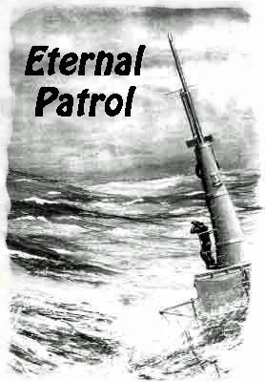
Notes:
And we should remember those sub sailors whose boats may have survived but who themselves departed on Eternal Patrol. Sailors, rest your oars. (Bell)

