Slide 1
TOLLING
FOR THE
BOATS
JULY

Slide 2
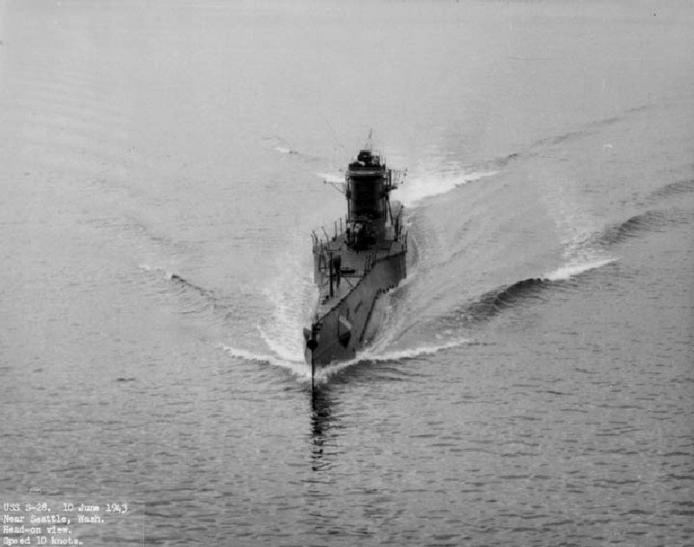
USS S-28 (SS-133)
Notes:
Following a Hawaii overhaul, USS S-28 (SS-133), on 3 July 1944, began training operations off Oahu. The antisubmarine warfare exercises continued into the evening of 4 July. As evening began contact between her and surface ships became sporadic and, at 18:20, the last, brief contact with S-28 was made and lost. All attempts to establish communications failed and a thorough search of the area failed to locate the submarine. A Court of Inquiry was unable to determine the cause of the loss of S-28. 49 Men Lost. (Bell & slide)

Slide 3
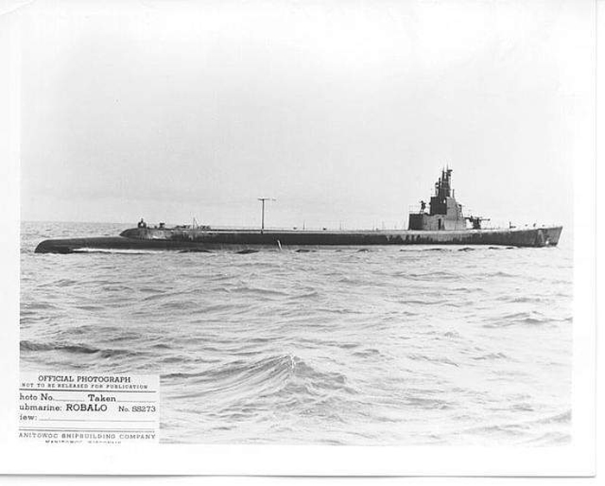
USS ROBALO (SS-273)
Notes:
USS ROBALO (SS-273) departed Fremantle on 22 June 1944 on her third war patrol. She set a course for the South China Sea to conduct her patrol in the vicinity of the Natuna Islands. After transiting Makassar Strait and Balabac Strait (which was well-known to be mined), she was scheduled to arrive on station about 6 July and remain until dark on 2 August 1944. On 2 July, a contact report stated ROBALO had sighted a FUSO-class battleship, with air cover and two destroyers for escort, just east of Borneo. No other messages were ever received from the submarine and when she did not return from patrol she was presumed lost. 81 Men Lost. (Bell & slide)

Slide 4
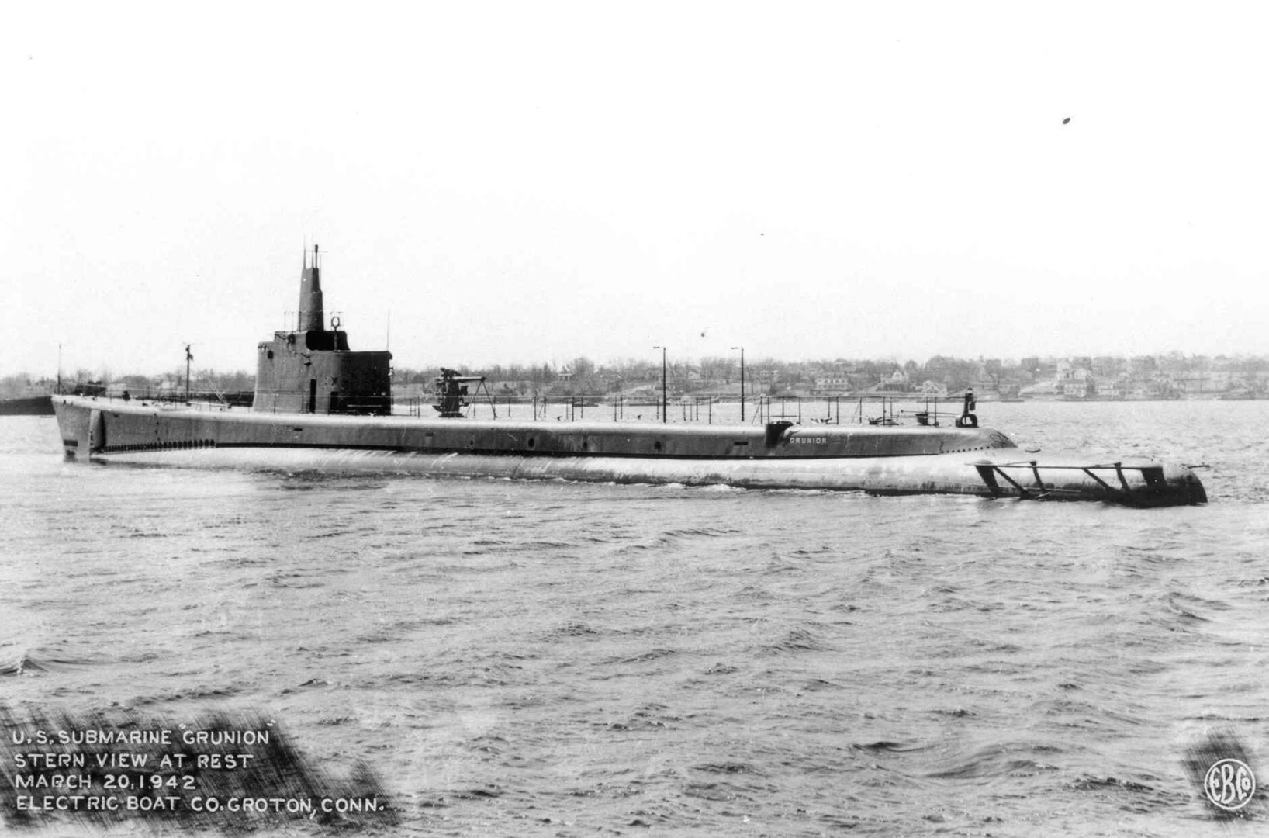
USS GRUNION (SS-216)
Notes:
USS GRUNION (SS-216) was lost on her first war patrol off Kiska Harbor, AK - presumed by enemy action - but officially "overdue and presumed lost." She radioed that she sank two sub-chasers and damaged a third, but was never heard from again. GRUNION’s mangled remains were found in the Bering Sea in 2006 off the Aleutian Island of Kiska. The final location was found and verified in 2008 but actual cause of her loss is still unknown. 70 Men Lost. (Bell & slide)

Slide 5
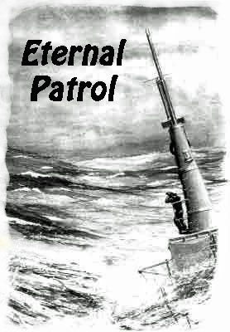
Notes:
And we should remember those sub sailors whose boats may have survived but who themselves departed on Eternal Patrol. Sailors, rest your oars. (Bell)

