Slide 1

TOLLING
FOR THE
BOATS
JUNE

Slide 2
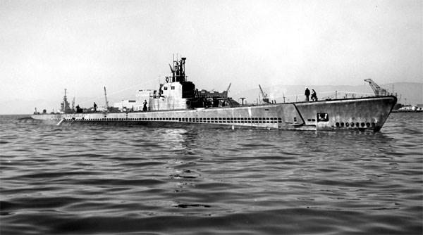
USS HERRING (SS-233)
Notes:
On her eighth war patrol, USS HERRING (SS-233) headed for the Kurile Islands patrol area. She later rendezvoused with BARB (SS-220) and then was never heard from or seen again. Japanese records prove that she sank two merchant ships at anchor in Matsuwa Island on the morning of 1 June 1944. In a counter-attack, enemy shore batteries scored two direct hits on the submarine's conning tower and "bubbles covered an area about 5 meters wide, and heavy oil covered an area of approximately 15 miles." 83 Men Lost. (Bell & slide)

Slide 3
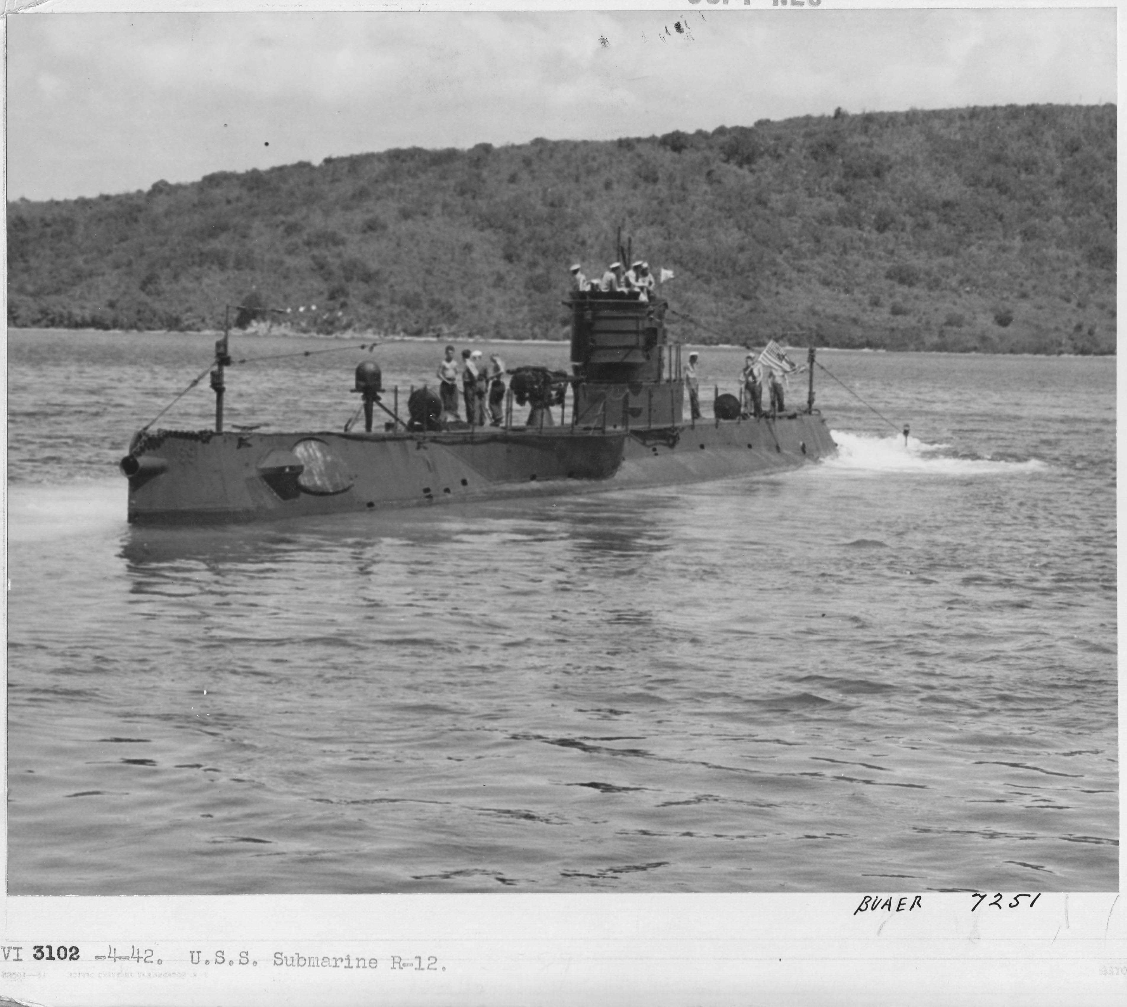
USS R-12 (SS-89)
Notes:
Shortly after noon on 12 June 1943, USS R-12 (SS-89), while underway to conduct a torpedo practice approach, sounded her last diving alarm. As she completed preparations to dive, the forward battery compartment began to flood. The collision alarm was sounded and a report was made that the forward battery compartment was flooding. Orders were given to blow main ballast, but the sea was faster. In about 15 seconds, R-12 was lost. The commanding officer, two other officers, and three enlisted men were swept from the bridge as the boat sank and were rescued. 42 Men Lost. (Bell & slide)

Slide 4
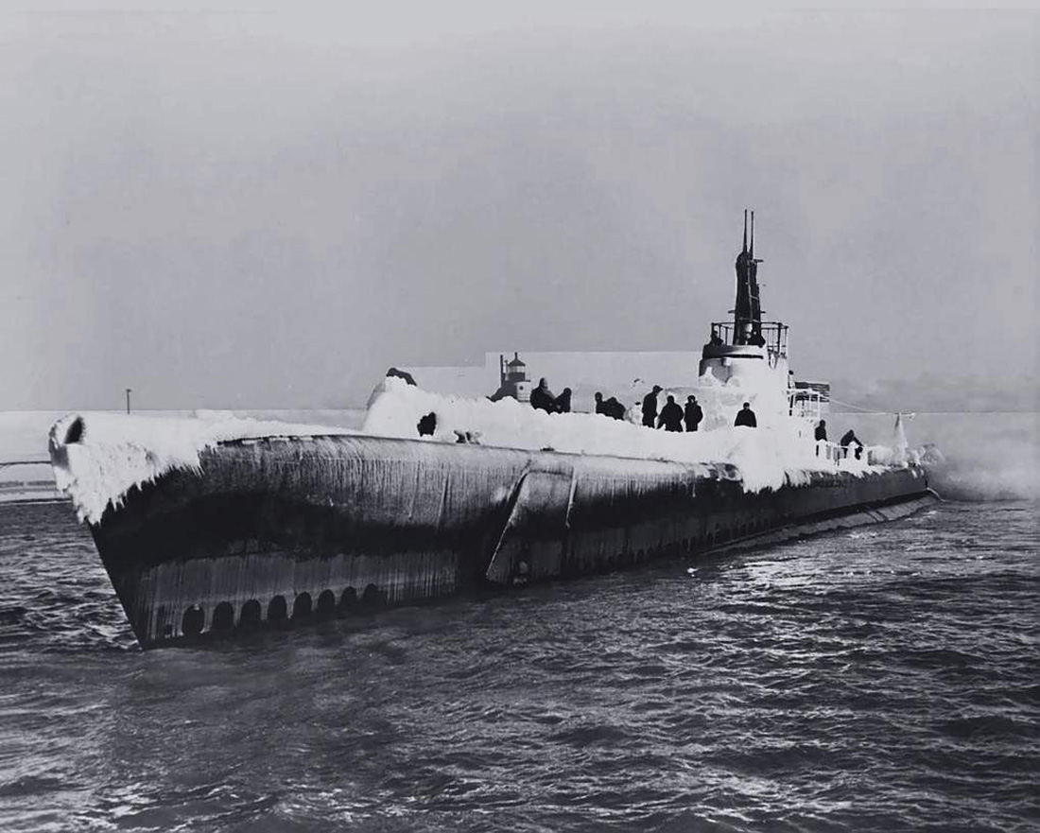
USS GOLET (SS-361)
Notes:
Japanese antisubmarine records available after the war revealed that USS GOLET (SS-361) was the probable victim of a Japanese antisubmarine attack made 14 June 1944. These records mention that the attack brought up corks, rafts, and other debris and a heavy pool of oil, all evidence of the sinking of a submarine. 82 Men Lost. (Bell & slide)

Slide 5
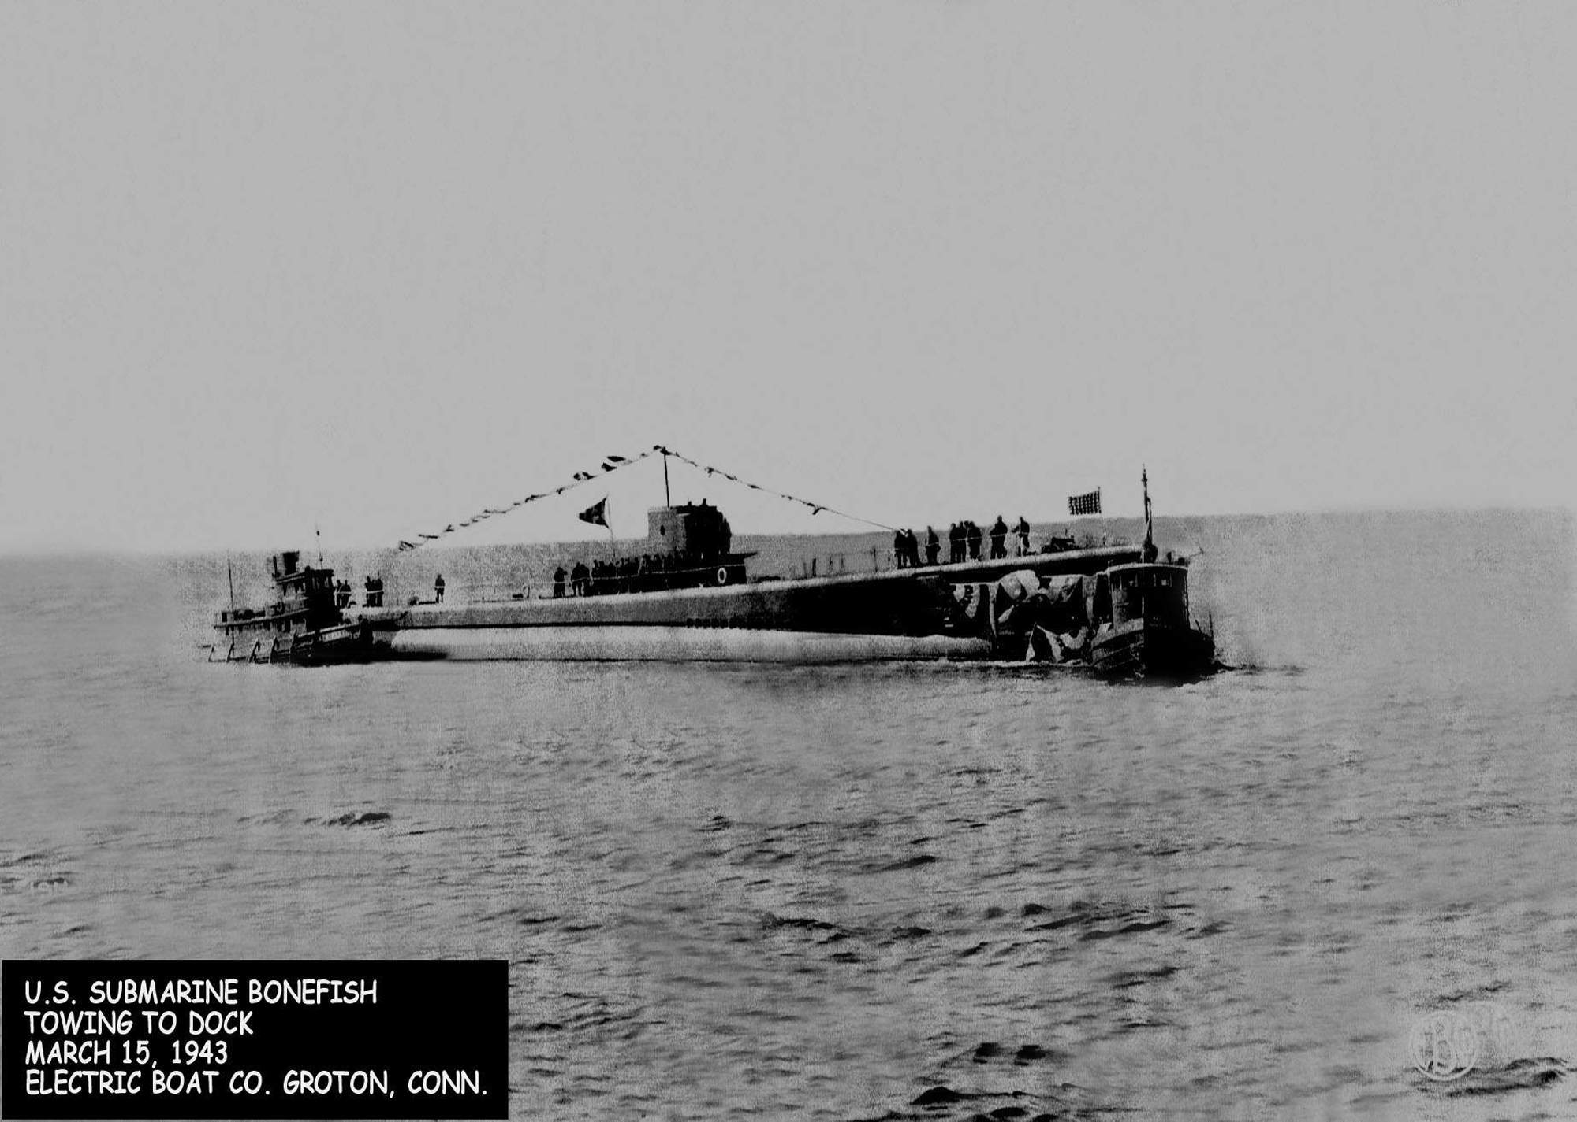
USS BONEFISH (SS-223)
Notes:
While operating in a wolf pack, USS BONEFISH (SS-223) requested and received permission to conduct a daylight submerged patrol of Toyama Wan, a bay farther up the Honshū coast. The boats were equipped with new mine detecting equipment. The attack group was to depart the Sea of Japan via La Perouse Strait on the night of 24 June. BONEFISH did not make the scheduled pre-transit rendezvous. Japanese records reveal that a 5,488 ton cargo ship was torpedoed and sunk in Toyama Wan on 19 June and that an ensuing severe counterattack by Japanese escorts brought debris and a major oil slick to the water's surface. There can be little doubt that BONEFISH was sunk in this action. 85 Men Lost. (Bell & slide)

Slide 6
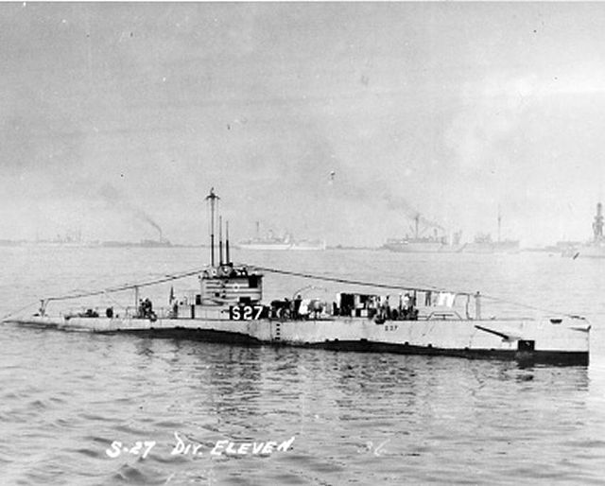
USS S-27 (SS-132)
Notes:
On 12 June, 1942, a little over a week after the beginning of the war in the Aleutians, USS S-27 (SS-132) pulled into Dutch Harbor, took on provisions, refueled, and then headed west with orders to patrol in the Kuluk Bay area. Soon after 00:43 on 19 June, breakers were sighted about 25 yards forward of the bow in fog off St. Makarius Point in the Aleutians. "Back emergency" orders were given. Seconds later, she grounded on rocks off St. Makarius. Wave action broke up the hull. No Men Lost. (Bell & slide)

Slide 7
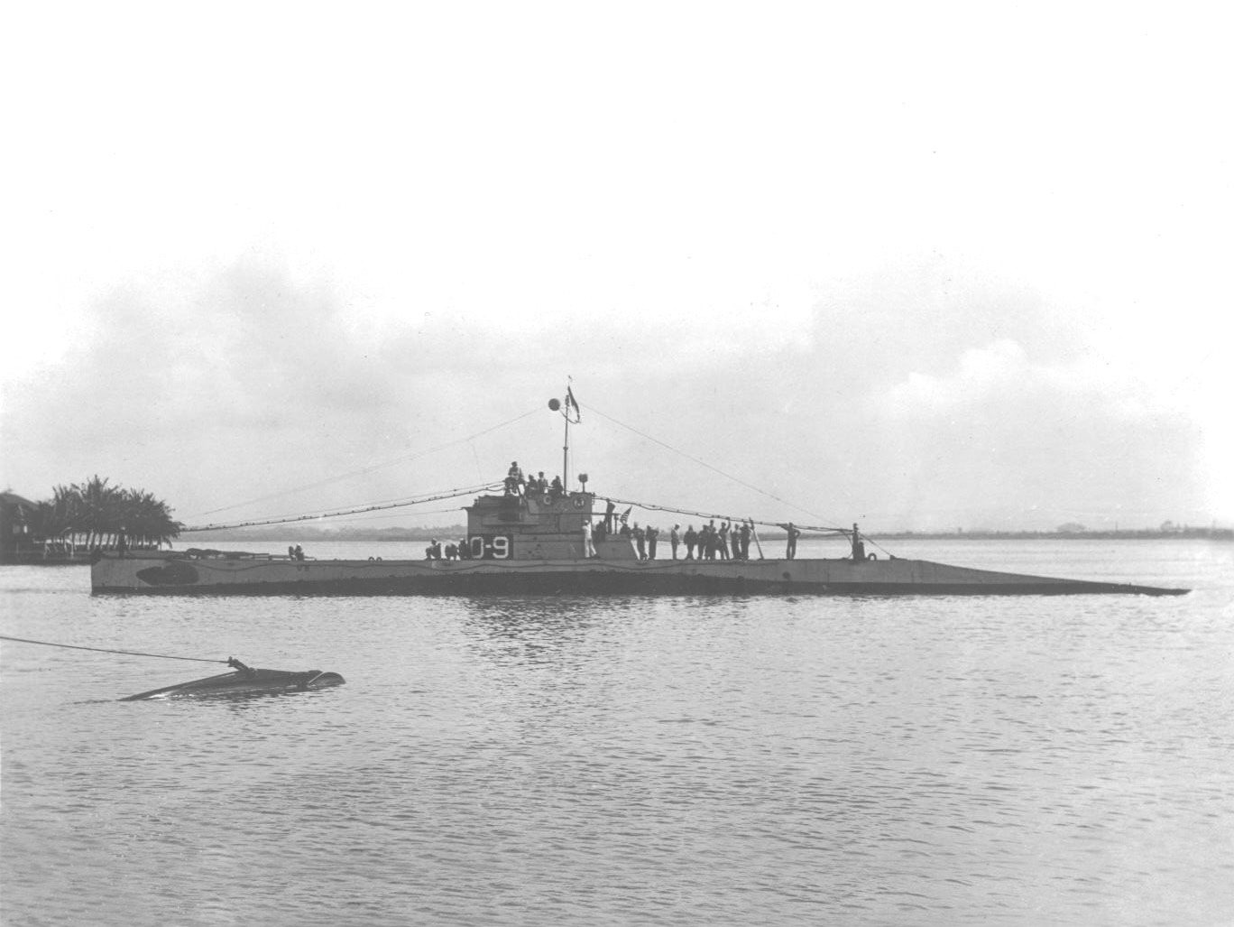
USS O-9 (SS-70)
Notes:
While conducting test dives off Portsmouth, NH with sister ships O-6 and O-10, USS O-9 (SS-70)
failed to surface. Flooding, which led to exceeding test depth caused the hull to crush. The actual hull location was located - but remains a secret - in 1997. 33 Men Lost. (Bell & slide)

Slide 8
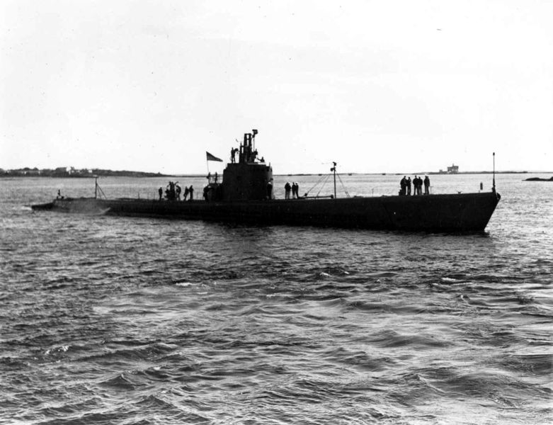
USS RUNNER (SS-275)
Notes:
On 27 May, 1943 USS RUNNER (SS-275) departed Midway for the Kuril Islands chain and waters off northern Japan. No report was heard from her after her departure. RUNNER was declared overdue and presumed lost in July 1943. 78 men lost. (Bell & slide)

Slide 9
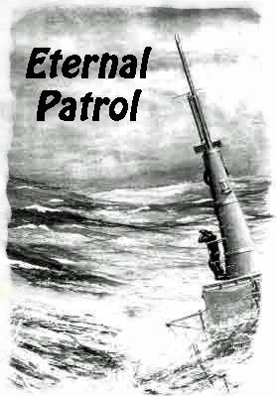
Notes:
And we should remember those sub sailors whose boats may have survived but who themselves departed on Eternal Patrol. Sailors, rest your oars. (Bell)

