Slide 1
TOLLING
FOR THE
BOATS
MAY

Slide 2
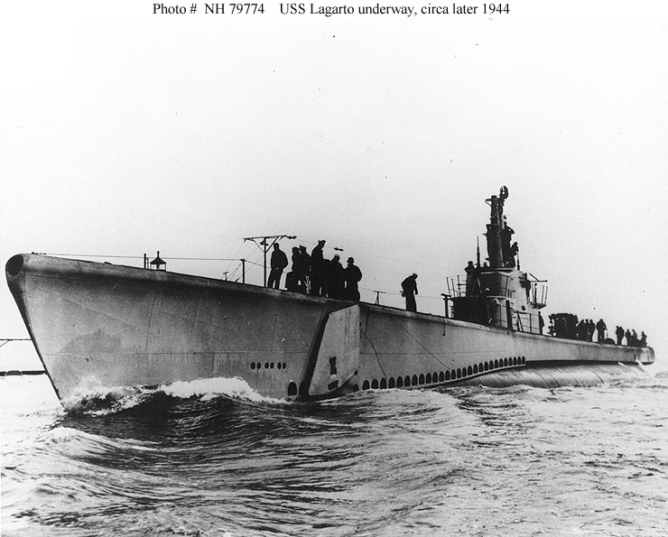
USS LAGARTO (SS-371)
Notes:
USS LAGARTO (SS-371), along with the submarine BAYA were engaged in heavy contact with enemy ships near the outer waters of the Gulf of Siam. At 15:00 on 3 May 1945, BAYA sent the first “of numerous contact reports to LAGARTO.” By 23:47, “having sent LAGARTO contact reports almost half hourly with no receipt,” BAYA decided to go it alone. Again, however, the Japanese escorts drove off BAYA when she attacked during the mid watch on 4 May, again saving their charges from destruction. Post-war examination of Japanese records revealed the most likely reason for LAGARTO’s silence. One of the two escorts made an attack on 3 May against a submerged submarine in 30 fathoms of water at LAGARTO's probable position. 86 Men Lost. (Bell & slide)

Slide 3
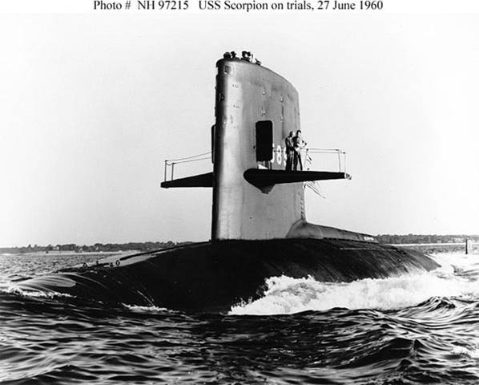
USS SCORPION (SSN-589)
Notes:
USS SCORPION (SSN-589) began a Mediterranean cruise in February 1968. The following May, while homeward bound from that tour, she was lost with her entire crew of 99 some 400 miles southwest of the Azores. In late October 1968, her remains were found on the sea floor over 10,000 feet below the surface by a towed deep-submergence vehicle deployed from USNS MIZAR (T-AGOR-11). Photographs taken then and later showed that her hull had suffered fatal damage while she was running submerged and that even more severe damage occurred as she sank. The cause of the initial damage continues to generate controversy more than three decades later. 99 men lost. (Bell & slide)

Slide 4
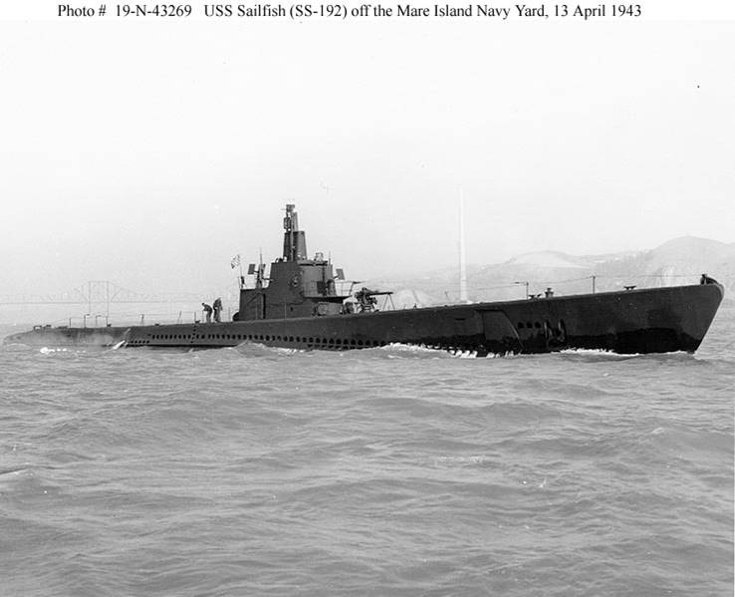
USS SQUALUS (SS-192)
Notes:
Commissioned in March 1939, USS SQUALUS (SS-192) was conducting test dives off the New Hampshire coast on 23 May when the main induction valve failed to close, flooding her aft compartments, and drowning 26 men. SQUALUS sank to the sea floor, over 200 feet below the surface. After heroic exertions by Navy divers, led by Commander Charles B. Momsen, her 33 surviving crewmen were rescued on 24 and 25 May 1939. The submarine was salvaged in an equally dramatic effort during the Summer of 1939. Decommissioned, repaired and renamed SAILFISH, she was re-commissioned in May 1940. 26 Men Lost. (Bell & slide)

Slide 5
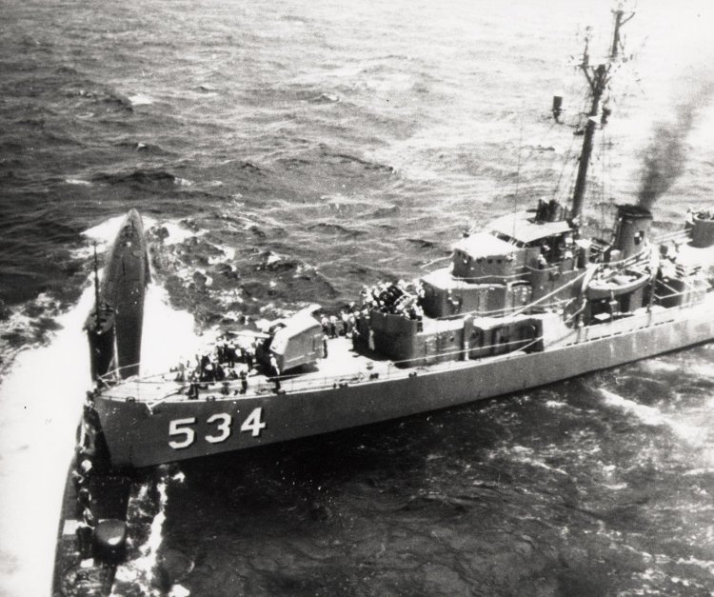
USS STICKLEBACK (SS-415)
Notes:
On 28 May 1958, USS STICKLEBACK (SS-415) was participating in an antisubmarine warfare exercise with a destroyer escort and torpedo retriever boat in the Hawaiian area. The exercises continued into the afternoon of the next day when the submarine completed a simulated torpedo run on the DE. As STICKLEBACK was going to a safe depth, she lost power and broached approximately 200 yards ahead of the destroyer escort. SILVERSTEIN backed full and put her rudder hard left in an effort to avoid a collision but holed the submarine on her port side. STICKLEBACK'S crew was removed by the retriever boat. Ships attempted to save the stricken submarine. The rescue ships put lines around her, but compartment after compartment flooded and, at 18:57 on 29 May 1958, STICKLEBACK sank in 1,800 fathoms of water. No Men Lost. (Bell & slide)

Slide 6
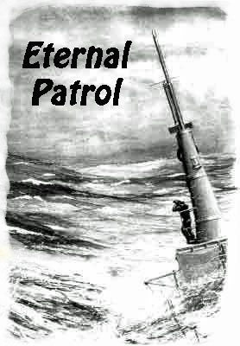
Notes:
And we should remember those sub sailors whose boats may have survived but who themselves departed on Eternal Patrol. Sailors, rest your oars. (Bell)

