Slide 1

TOLLING
FOR THE
BOATS
APRIL

Slide 2
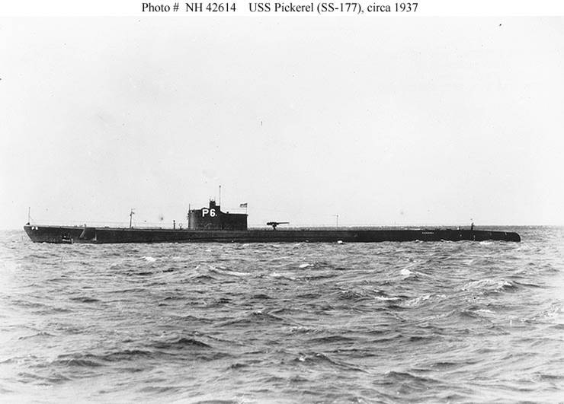
USS PICKEREL (SS-177)
Notes:
USS PICKEREL (SS-177) was lost while on her 7th war patrol. She was lost off Honshū. The exact cause of her loss has never been determined, but her OP area contained numerous minefields. 74 Men Lost. (Bell & slide)

Slide 3
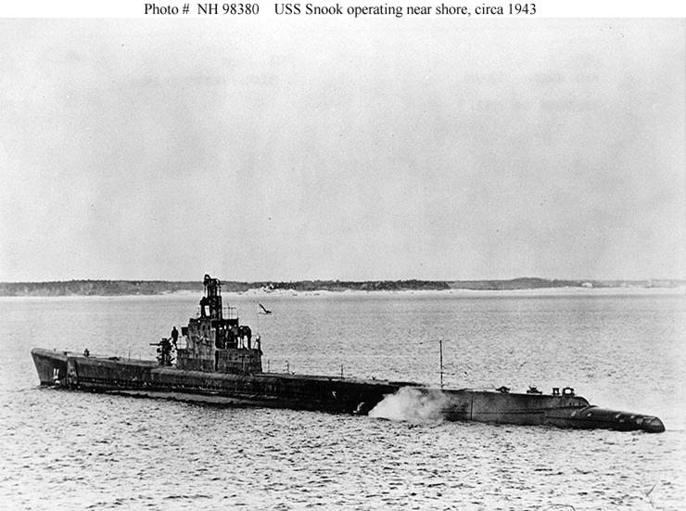
USS SNOOK (SS-279)
Notes:
USS SNOOK (SS-279) was lost while conducting her ninth war patrol, in the South China Sea and Luzon Strait. It is believed that she was sunk by kaibokans OKINAWA, CD-8, CD-32 and CD-52. It has also been suggested that SNOOK may have been lost due to one of five Japanese submarines were which also lost in April–May 1945. One candidate is Japanese submarine I-56. 84 men lost. (Bell & slide)

Slide 4
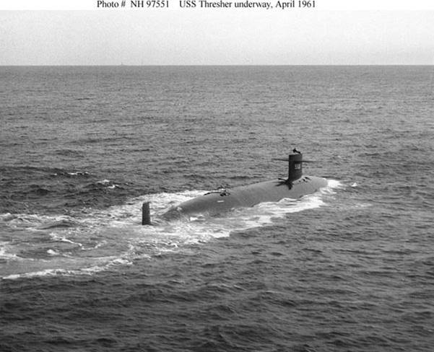
USS THRESHER (SSN-593)
Notes:
It is believed a brazed pipe-joint ruptured in the USS THRESHER (SSN-593) engine room. The crew would have attempted to stop the leak; at the same time, the engine room would be filling with a cloud of mist. Water leaking from the broken pipe most likely causes short circuits leading to an automatic shutdown of the ship's reactor, causing a loss of propulsion. Procedures at the time would have shutdown steam propulsion. Loss of sufficient motive power and added weight (flooding) caused the ship to sink past crush depth. 129 Men Lost. (Bell & slide)

Slide 5
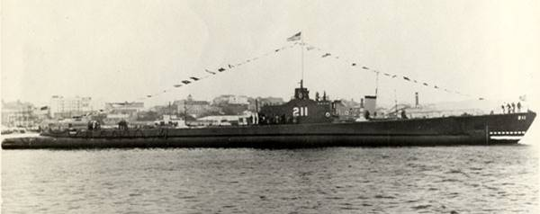
USS GUDGEON (SS-211)
Notes:
USS GUDGEON (SS-211) was sunk 18 April 1944 by a Japanese aircraft south-east of Iwo Jima. Although there has been some confusion in past translations of the Japanese accounts casting doubt on the report, the pilot of the attacking aircraft, reported he was patrolling to the south-east of "sulphur island" when they sighted the sub. "Sulphur" in Japanese is "Iwo" so there is little doubt at this point that GUDGEON met her fate south-east of Iwo Jima on April 18th. 79 Men Lost. (Bell & slide)

Slide 6
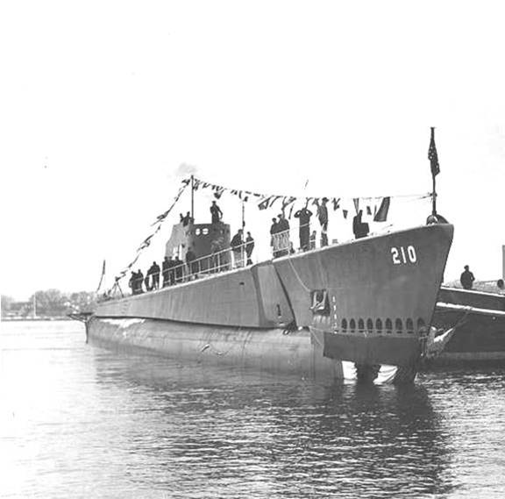
USS GRENADIER (SS-210)
Notes:
Sent to the shallow Strait of Malacca for her sixth patrol USS GRENADIER (SS-210) was attacked by Japanese aircraft while approaching a convoy on 21 April, 1943, and badly damaged by a bomb explosion after submerging. Her crew struggled to make her seaworthy, but her propeller shafts were so badly bent that she could not get underway, and she had to be scuttled when enemy ships approached on 22 April 1943. GRENADIER's entire crew was picked up by the Japanese, who employed prolonged torture in an unsuccessful effort to extract intelligence information. Four of her men died as prisoners of war before the rest were freed following Japan's surrender more than two years later. (Bell & slide)

Slide 7
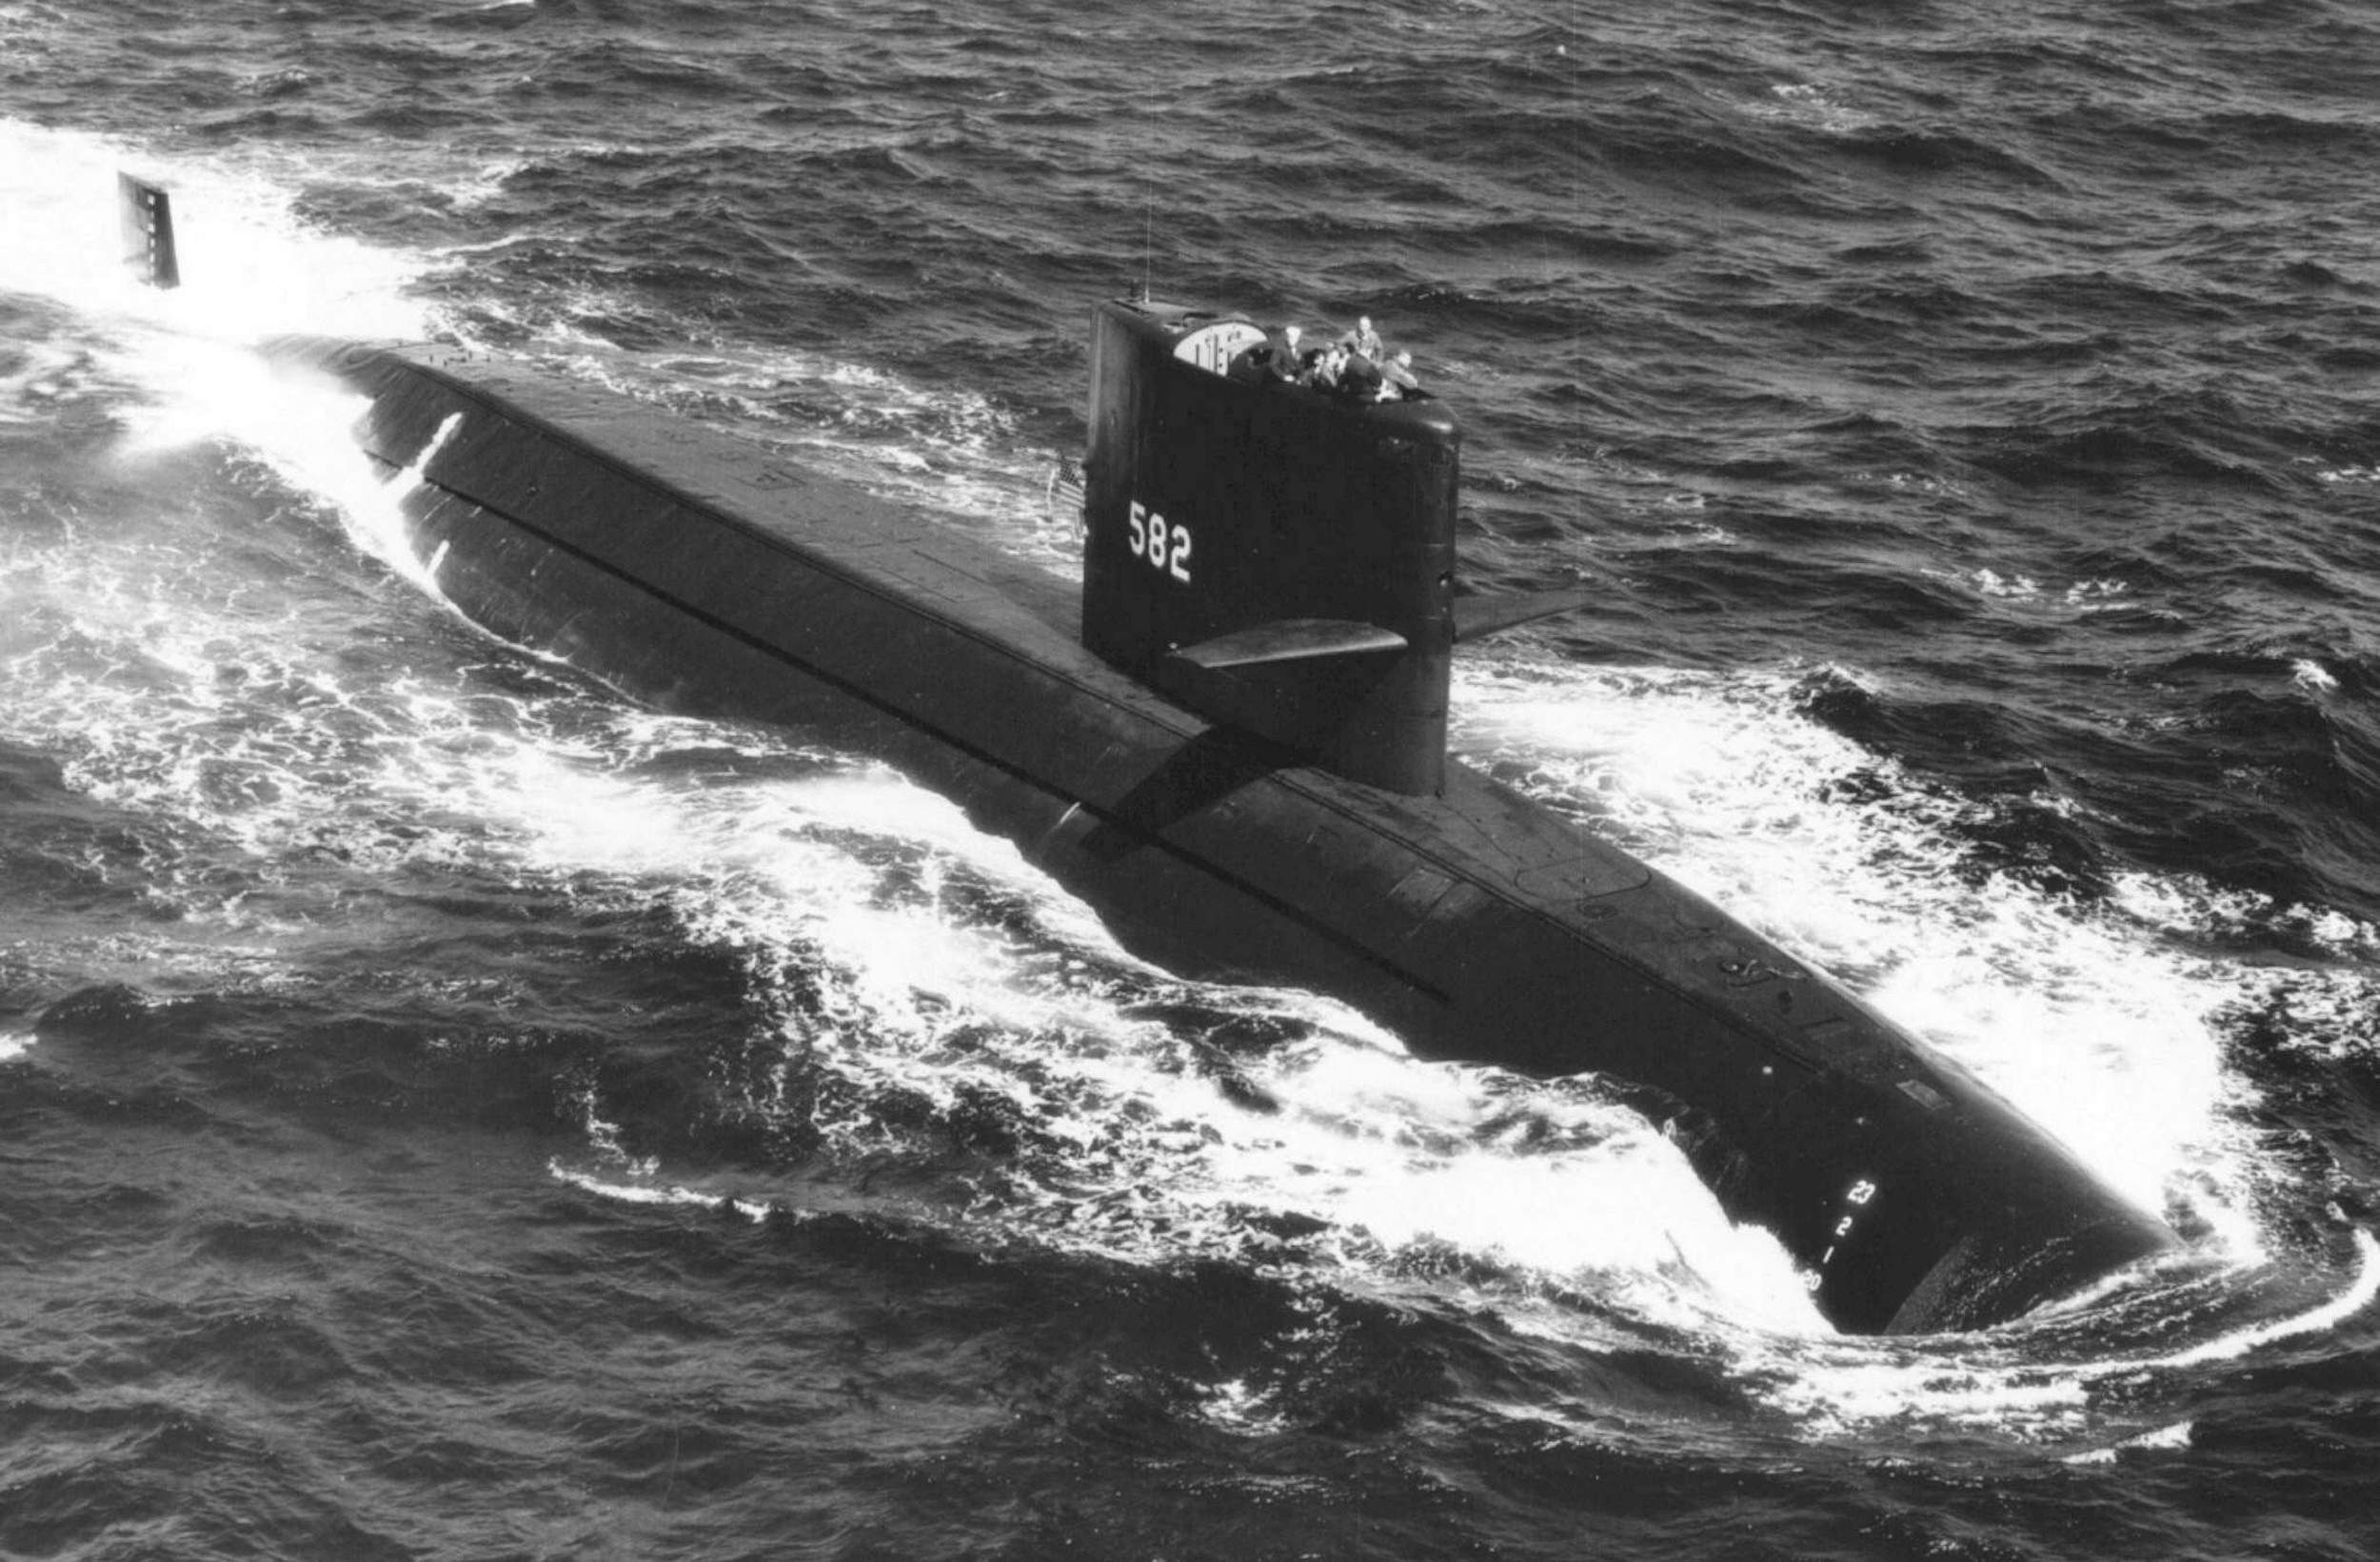
USS BONEFISH (SS-582)
Notes:
Damaged on 24 April 1988 due to an explosion and fire in the Battery space during an exercise off the Atlantic Coast of Florida. Crew was ordered to abandon ship with 92 men onboard. 89 survived and were rescued, 3 men were lost. Bonefish was towed to Charleston, SC, declared unrepairable, decommissioned, and scrapped. (Bell & slide)

Slide 8
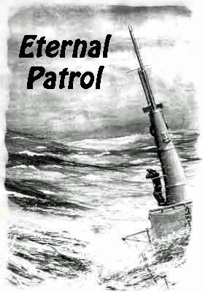
Notes:
And we should remember those sub sailors whose boats may have survived but who themselves departed on Eternal Patrol. Sailors, rest your oars. (Bell)

