Slide 1
TOLLING
FOR THE
BOATS
MARCH

Slide 2
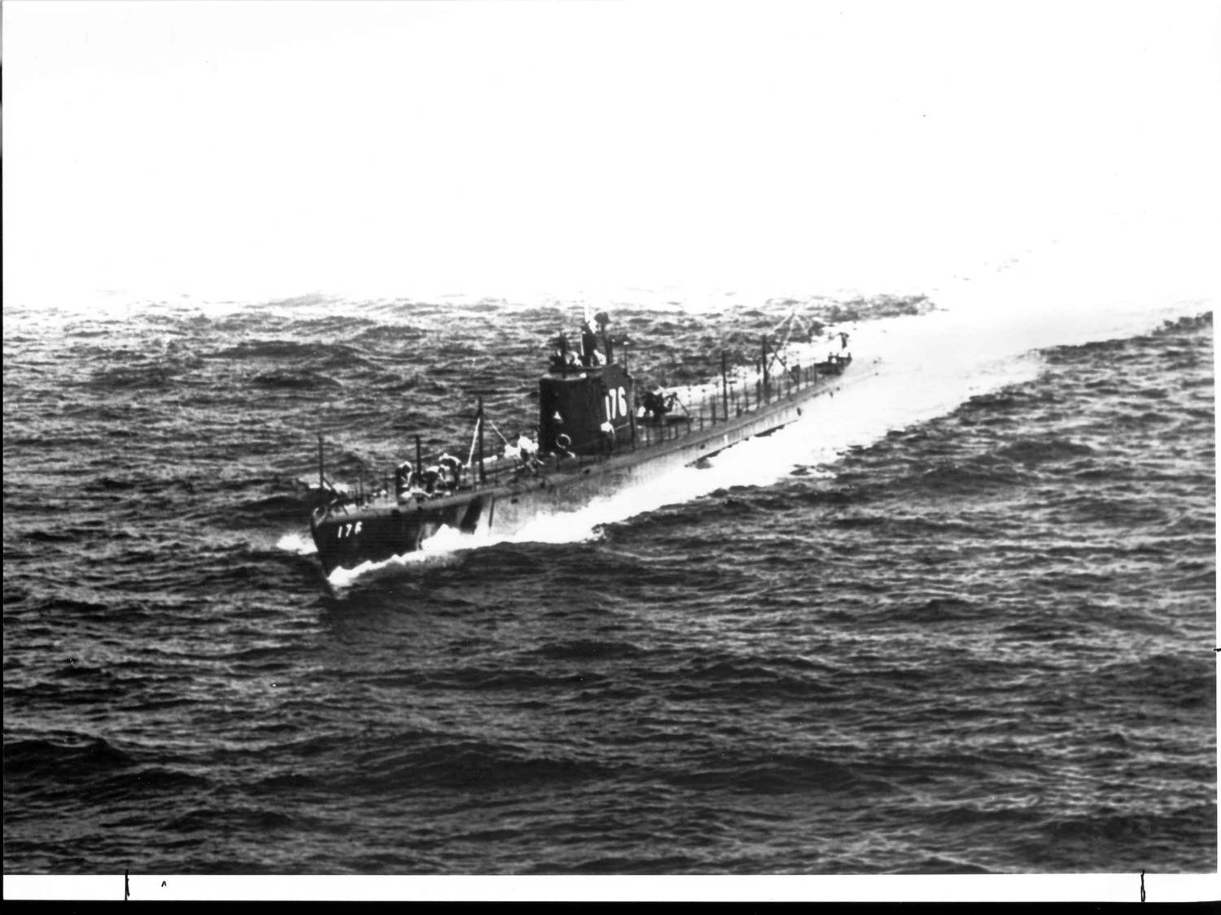
USS PERCH (SS-176)
Notes:
USS PERCH (SS-176) began her second combat cruise in February 1942. Initially patrolling off Celebes, she received damage in an attack on an enemy ship on the 25th, and was then transferred to the waters north of Java. During the night of 1 March she was the object of a depth charge attack by two destroyers, which left her in a crippled condition. Another depth charging the next day made her problems grow even worse. Perch attempted to leave the area, but was trapped half-submerged in shallow water. Surrounded by enemy ships, her Commanding Officer ordered the submarine abandoned and scuttled early on 3 March 1942. Her officers and men were promptly taken captive, and six of them did not survive the more than three years they spent as prisoners of war. (Bell & slide)

Slide 3
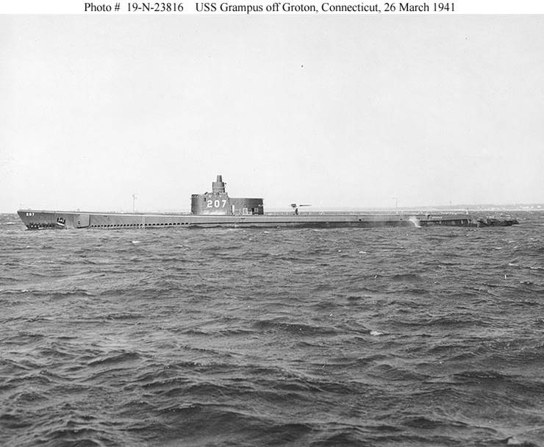
USS GRAMPUS (SS-207)
Notes:
USS GRAMPUS (SS-207) left Brisbane, Australia, in mid-February 1943 to begin her sixth patrol, in the Solomons. GRAMPUS did not return from this mission and was subsequently declared lost with all hands. It is possible that she was sunk by the Japanese destroyers MINEGUMO and MURASAME in a battle fought in the Blackett Strait, near Kolombangara Island, on 5 March 1943, shortly before those enemy ships were sunk in a night action with U.S. cruisers and destroyers. 71 men lost. (Bell & slide)

Slide 4
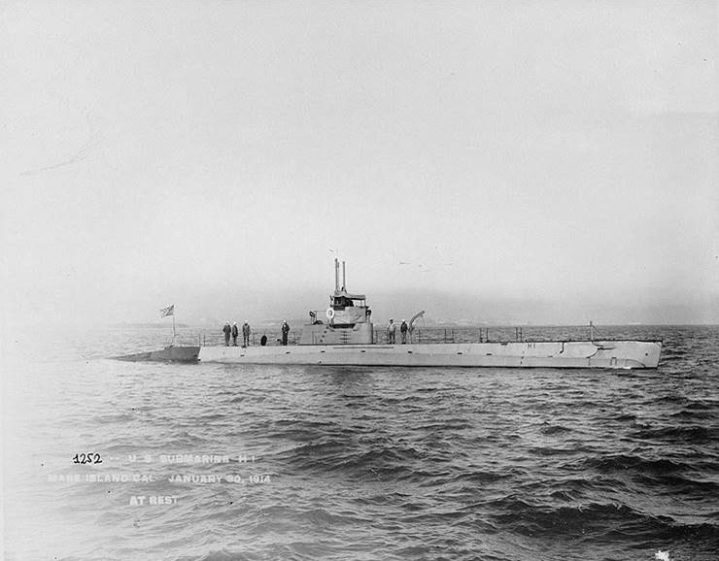
USS H-1 (SS-28)
Notes:
USS H-1 (SS-28) was lost on March 12, 1920 with the loss of 4 men as they tried to swim to shore after grounding on a tricky shoal off Santa Margarita Island, off the coast of Baja California, Mexico. VESTAL (AR-4), pulled H-1 off the rocks in the morning of 24 March, only to have her sink 45 minutes later in some 50 feet of water. She was originally named the USS SEAWOLF before becoming H-1. (Bell & slide)

Slide 5
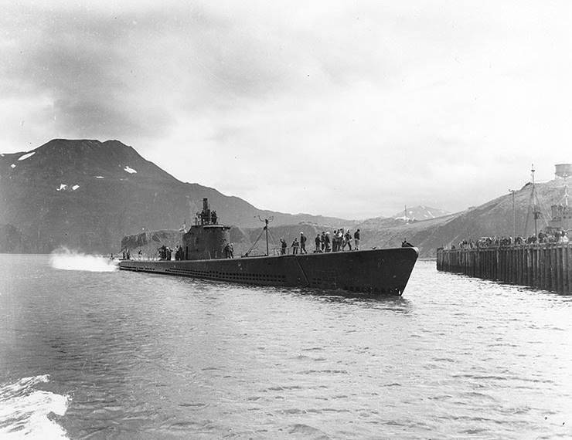
USS TRITON (SS-201)
Notes:
In late January 1943, USS TRITON (SS-201) was sent to operate against enemy shipping north of the Solomon Islands. She sank one cargo ship in early March and attacked others, but was not heard from after the 11th of the month and in April was reported overdue and presumed lost. Postwar analysis concluded that USS TRITON, with her entire crew of seventy-four officers and men, was probably sunk by Japanese destroyers off the Admiralty Islands on 15 March 1943. 74 Men Lost. (Bell & slide)

Slide 6
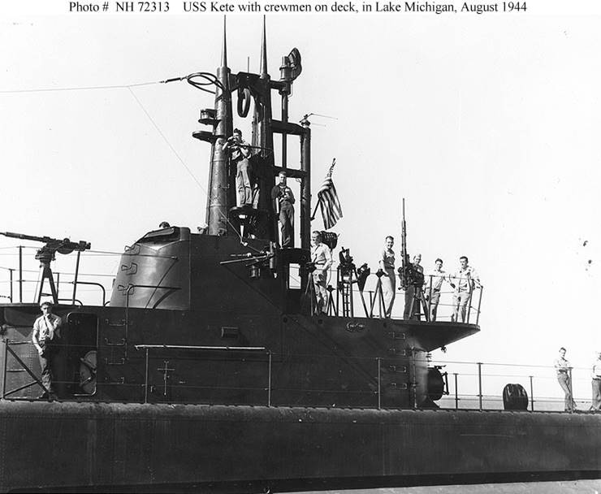
USS KETE (SS-369)
Notes:
USS KETE’s (SS-369) second war patrol, under the command of Lieutenant Commander Edward Ackerman, commenced in early March and took her to the waters off Okinawa. She sank three small cargo ships during a 10 March, 1945, attack on an enemy convoy and sent a weather report on the 20th, the date she was supposed to depart the patrol area. KETE was not heard from again and was finally reported as lost. She may have been the victim of a Japanese submarine's torpedoes. Her entire crew of 87 officers and men was lost with her. (Bell & slide)

Slide 7
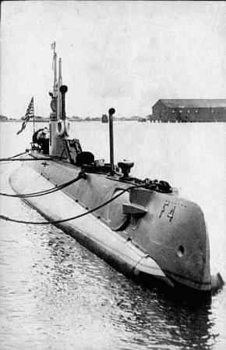
USS F-4 (SKATE) (SS-23)
Notes:
During submarine maneuvers off Honolulu, Hawaii on 25 March 1915, USS F-4 (SS-23) sank at a depth of 306 feet, 1.5 mi from the harbor. Despite valorous efforts of naval authorities at Honolulu to locate the missing boat and save her crew, all 21 perished. F-4 was the first commissioned submarine of the U.S. Navy to be lost at sea. She was raised in August 1915. The remains of F-4 were buried as fill in a trench off the Submarine Base, Pearl Harbor, HI. Investigation concluded that acid corrosion of the lead lining of the battery tank let seawater into the battery compartment, causing loss of control. 21 Men Lost. (Bell & slide)

Slide 8
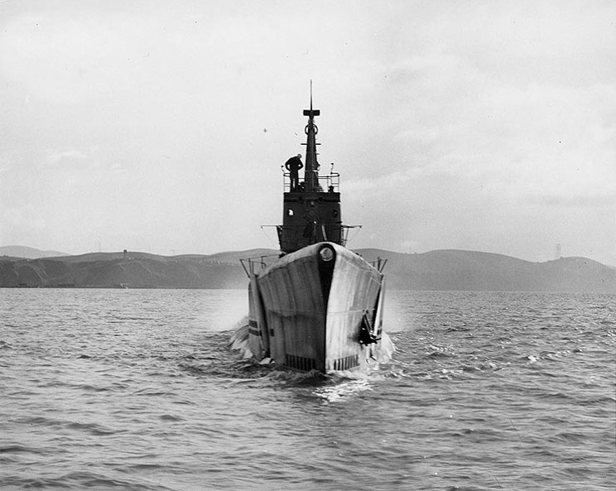
USS TULIBEE (SS-284)
Notes:
USS TULIBEE (SS-284) was sent to the Palaus area for her fourth patrol, which began early in March 1944. On the 26th of that month, while attacking a convoy, USS Tullibee was sunk when one of her own torpedoes apparently circled back and hit her. Only one Sailor survived from her crew of eighty. (Bell & slide)

Slide 9
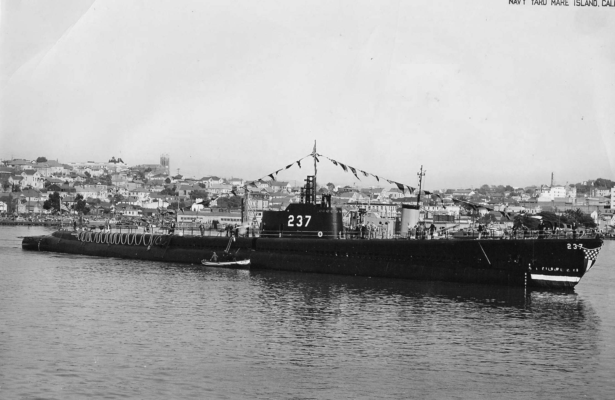
USS TRIGGER (SS-237)
Notes:
On 24 March 1945, USS TRIGGER (SS-237) was ordered to join a wolf pack and to acknowledge receipt of the message. A weather report came from the submarine that day but no confirmation of her having received the message. The weather report was TRIGGER's last transmission. Postwar records indicate she torpedoed and sank a Japanese repair ship, but the next day, Japanese planes and ships joined in a two-hour attack on a submarine heard by other boats in the wolf pack. Japanese records showed a Japanese aircraft detected and bombed a submarine on 28 March 1945. Destroyers were then guided to the spot and delivered an intensive depth charging. After two hours, a large oil slick appeared. 89 Men Lost. (Bell & slide)

Slide 10
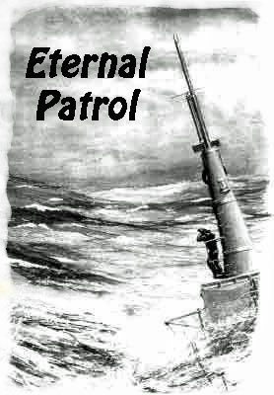
Notes:
And we should remember those sub sailors whose boats may have survived but who themselves departed on Eternal Patrol. Sailors, rest your oars. (Bell)

