Slide 1
TOLLING
FOR THE
BOATS
FEBRUARY

Slide 2
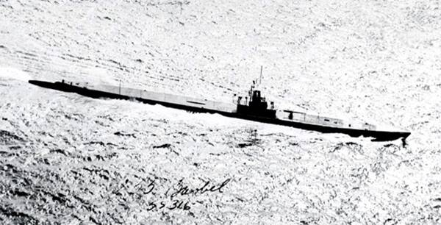
USS BARBEL (SS-316)
Notes:
On February 3rd, 1945, USS BARBEL (SS-316) was attacked by aircraft three times with depth charges near the southern entrance to the Palawan Passage, and stated she would transmit a message “tomorrow night” giving information. This was the last contact with BARBEL. 81 men lost. (Bell & slide)

Slide 3
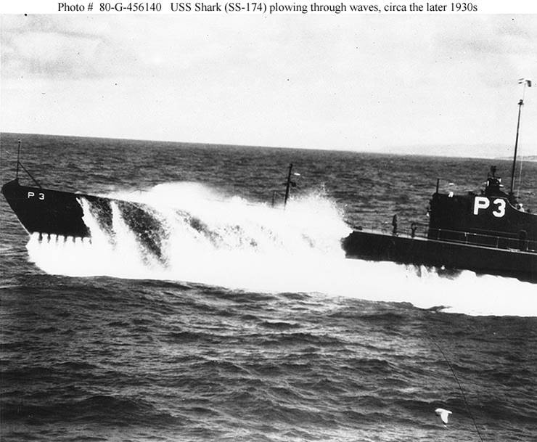
USS SHARK I (SS-174)
Notes:
On February 2nd, 1942, USS SHARK I (SS-174) reported to Surabaya that she had been depth charged 10 miles off Tifore Island and that she had missed on one torpedo attack. Five days later SHARK reported an empty enemy cargo ship heading northeast. No further messages were received from SHARK. She was sunk by enemy surface craft on February 11, 1942. 59 men lost. (Bell & slide)

Slide 4
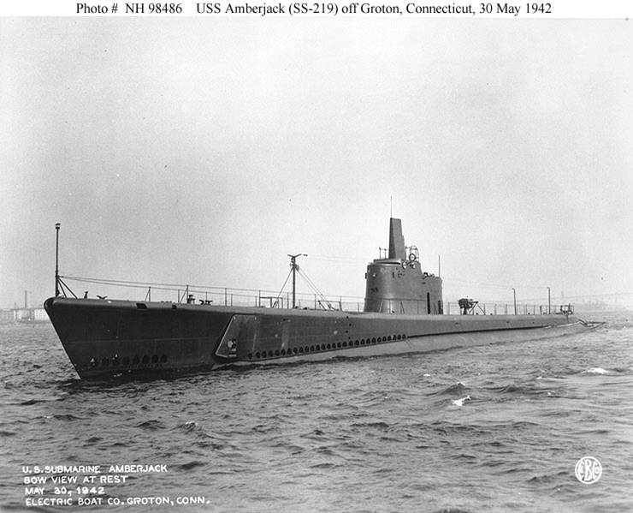
USS AMBERJACK (SS-219)
Notes:
On 16 February 1943, off the coast of Rabaul, USS AMBERJACK (SS-219) was attacked by a Japanese patrol plane, attacked by a torpedo boat and then depth charged by a sub chaser. She reported having sunk a freighter early in February and checked in again on February 14th. USS AMBERJACK was not heard from again and was officially presumed sunk when she failed to return to port. 72 men lost. (Bell & slide)

Slide 5
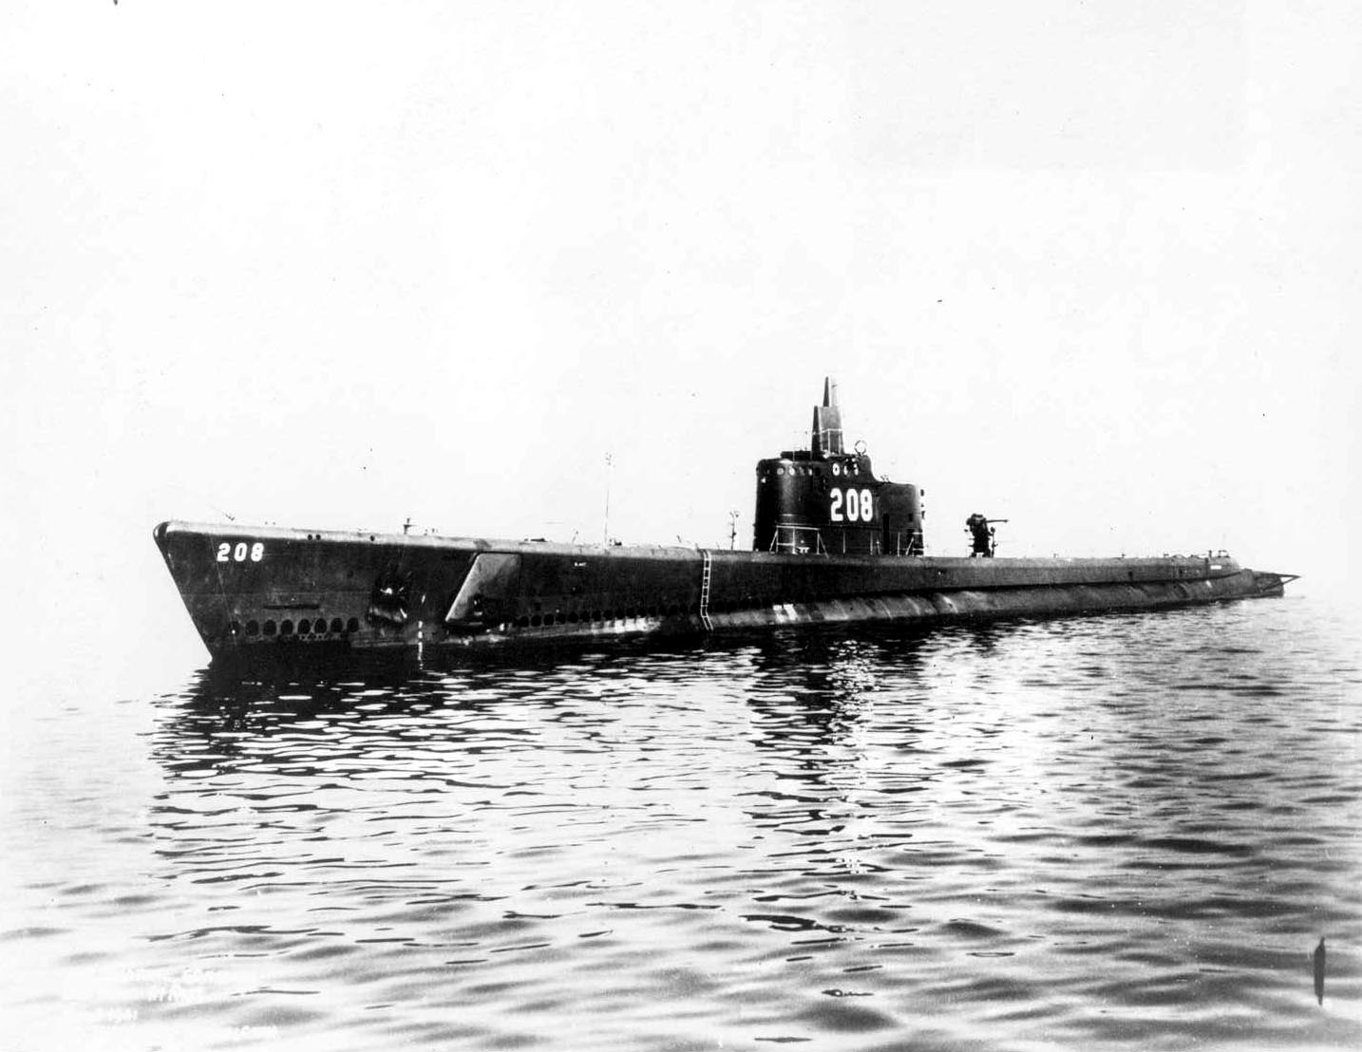
USS Grayback (SS-208)
Notes:
USS Grayback’s (SS-208) tenth patrol, her most successful in terms of tonnage sunk, was also to be her last. From captured Japanese records the submarine's last few days can be pieced together. Heading home through the East China Sea, on 27 February, 1944, GRAYBACK used her last two torpedoes to sink the freighter CEYLON MARU. That same day, a Japanese carrier-based plane spotted a submarine on the surface in the East China Sea and attacked. According to Japanese reports the submarine "exploded and sank immediately," but antisubmarine craft were called in to depth-charge the area, clearly marked by a trail of air bubbles, until at last a heavy oil slick swelled to the surface. GRAYBACK had ended her last patrol, one which cost the enemy some 21,594 tons of shipping. 81 men lost. (Bell & slide)

Slide 6
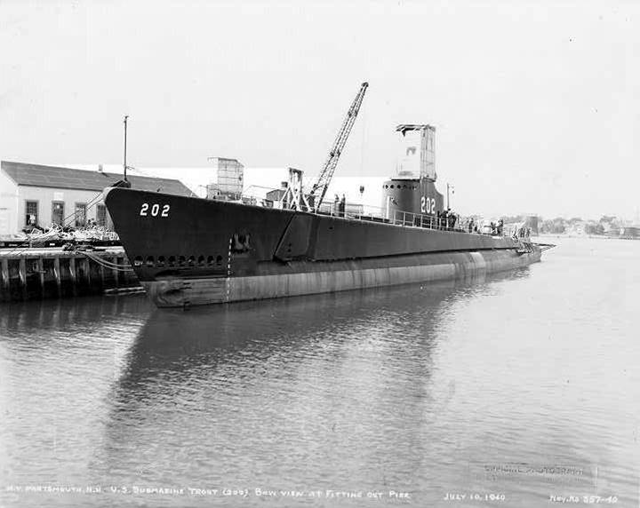
USS TROUT (SS-202)
Notes:
On 29 February 1944, USS TROUT (SS-202) was sunk by enemy escorts in the middle of the Philippines Basin after sinking a passenger-cargoman and damaging another convoy. 81 men lost. (Bell & slide)

Slide 7
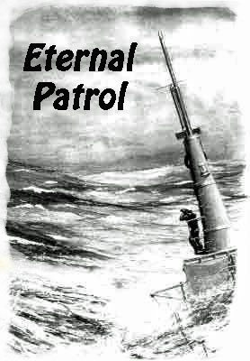
Notes:
And we should remember those sub sailors whose boats may have survived but who themselves departed on Eternal Patrol. Sailors, rest your oars. (Bell)

