Slide 1
TOLLING
FOR THE
BOATS
JANUARY

Slide 2
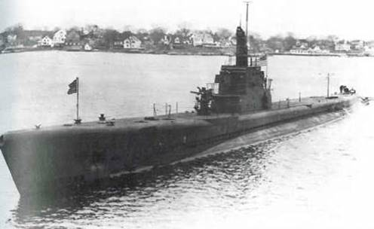
USS SCORPION (SS-278)
Notes:
USS SCORPION (SS-278) During her wartime career SCORPION sank 18,316 tons of Japanese shipping. After a rendezvous with USS HERRING (SS-233) the afternoon of January 5, 1944, SCORPION was never seen or heard from again. Sometime after January 5th 1944, she was lost in the East China Sea on her 4th War patrol. She was presumed lost to a mine. 77 Men Lost. (Bell & slide)

Slide 3
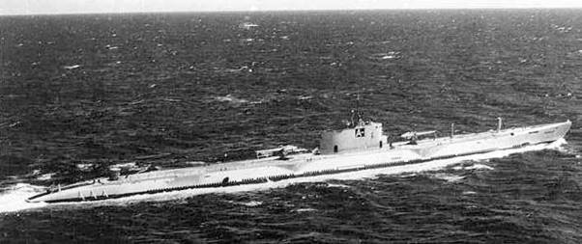
USS ARGONAUT (SS-166)
Notes:
On her 3rd War Patrol, USS ARGONAUT (SS-166) was lost with all hands on January 10th, 1943. The loss of her crew of 102 was the worst loss of life for a wartime submarine. While attacking a Japanese convoy, she was lost to depth charges and direct fire from Japanese destroyers. 102 Men Lost. (Bell & slide)

Slide 4
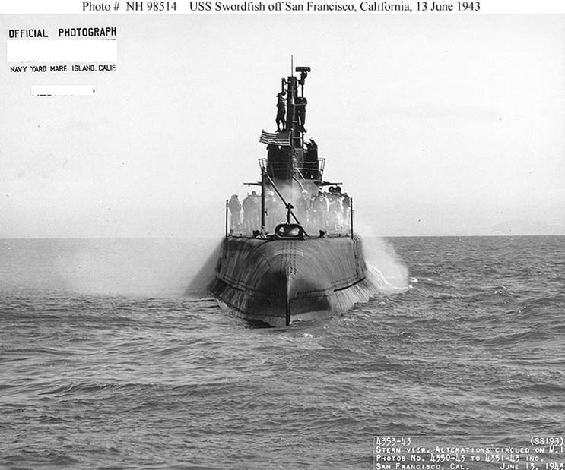
USS SWORDFISH (SS-193)
Notes:
USS SWORDFISH (SS-193) was lost on January 12th, 1945, with the loss of her crew of 89 officers and enlisted men near Okinawa, on her 13th war patrol. She was presumed to be lost to a mine. 89 Men Lost. (Bell & slide)

Slide 5
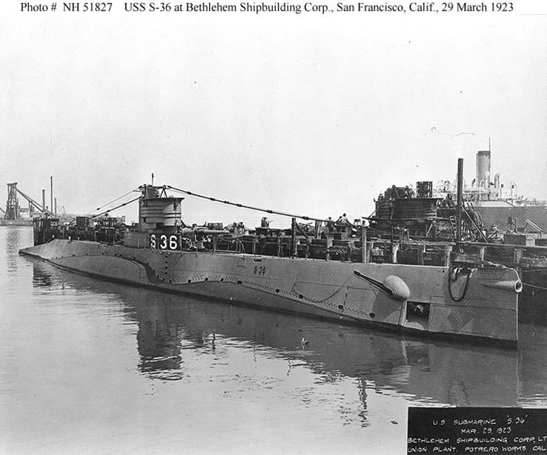
USS S-36 (SS-141)
Notes:
USS S-36 (SS-141) was lost on January 20th, 1942, on first war patrol. After numerous material problems she ran hard aground on a reef and radioed for help. The entire crew was rescued by a Dutch ship after they scuttled her. No Men Lost. (Bell & slide)

Slide 6
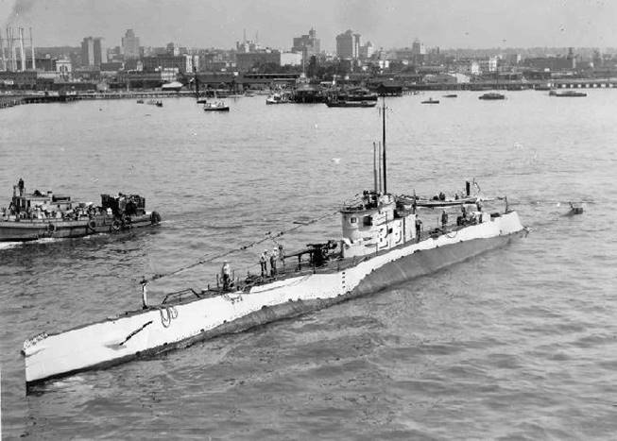
USS S-26 (SS-131)
Notes:
USS S-26 (SS-131) was lost in the Gulf of Panama on the night of January 24th, 1942, on her second war patrol. 46 officers and enlisted perished. She was rammed by the submarine chaser USS STURDY, PC-460 and sunk within seconds. The CO and XO and one lookout on the bridge were the only survivors. 46 Men Lost. (Bell & slide)

Slide 7
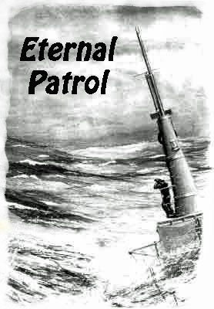
Notes:
And we should remember those sub sailors whose boats may have survived but who themselves departed on Eternal Patrol. Sailors, rest your oars. (Bell)

