Slide 1
Unauthorized History of the Pacific War Podcast
https://www.youtube.com/channel/UCzEcARkk8d1XdLbo2koY_UA/featured
Initial Response Phase 1941 - 1942 (S-Boats & Fleet Boats)
Notes:
https://www.youtube.com/watch?v=Znk5QINe01A ⬄ Sarah C. M. Paine, Historian, US Naval War College – Reasons for Japanese Decision to Attack the USA – Cultural || Economic

Slide 2
Unauthorized History of the Pacific War Podcast
Hosts:
Seth Paridon, Historian, MS Military Museum & Bill Toti, Captain, USN, Retired
Guest:
Thomas Boulton Fargo, Admiral, USN, former USPACOM
Discussion Topic:
Introduction to the Silent Service with Admiral Thomas Fargo-Episode 201
https://www.youtube.com/watch?v=rt5s6Vpn2zE
Notes:
Admiral Fargo served as the inspiration for the character of Captain Bart Mancuso in the film The Hunt for Red October.

Slide 3
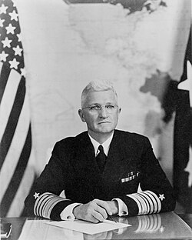
CNO - Admiral Harold Raynsford Stark
Ordered Unrestricted Submarine Warfare within 4 Hours of Pearl Harbor Attack
Notes:
No Survivors

Slide 4
US Navy Pacific Submarine Forces 1942
Pre-War: Economic Embargo & Critical Resources Restrictions
Oil | Rubber | Rice | Timber | Minerals | Metals
What the Japanese failed to accomplish at Pearl Harbor
Aircraft Carriers | Submarines | Oil Storage Capacity | Shipyards
Implications of Unrestricted Submarine Warfare
Violations of Maritime Laws | International Laws of Armed Conflict
Notes:
Aircraft Carriers | Submarines | Oil Storage Capacity | Shipyards
Combat War Patrols singularly or in Phases, Concurrent Special Operations Patrols Not Addressed Separately / Kept Classified & Unacknowledged

Slide 5
US Navy Pacific Submarine Forces 1942
What are the available United States Submarine Forces
Porpoise Class | 10 Boats (SS-176 USS Perch)
Salmon Class | 6 Boats (SS-182 USS Salmon)
Sargo Class | 10 Boats (SS-189 USS Saury)
Tambor / Gar Class | 6/6 Boats (SS-198) USS Tambor
* 6 Tubes FWD | *500 Foot DD 250 Foot TD | First “Fleet” Boats
What are the Mission Priorities (1942) of the Pacific Submarines
Notes:
Aircraft Carriers | Submarines | Oil Storage Capacity | Shipyards

Slide 6
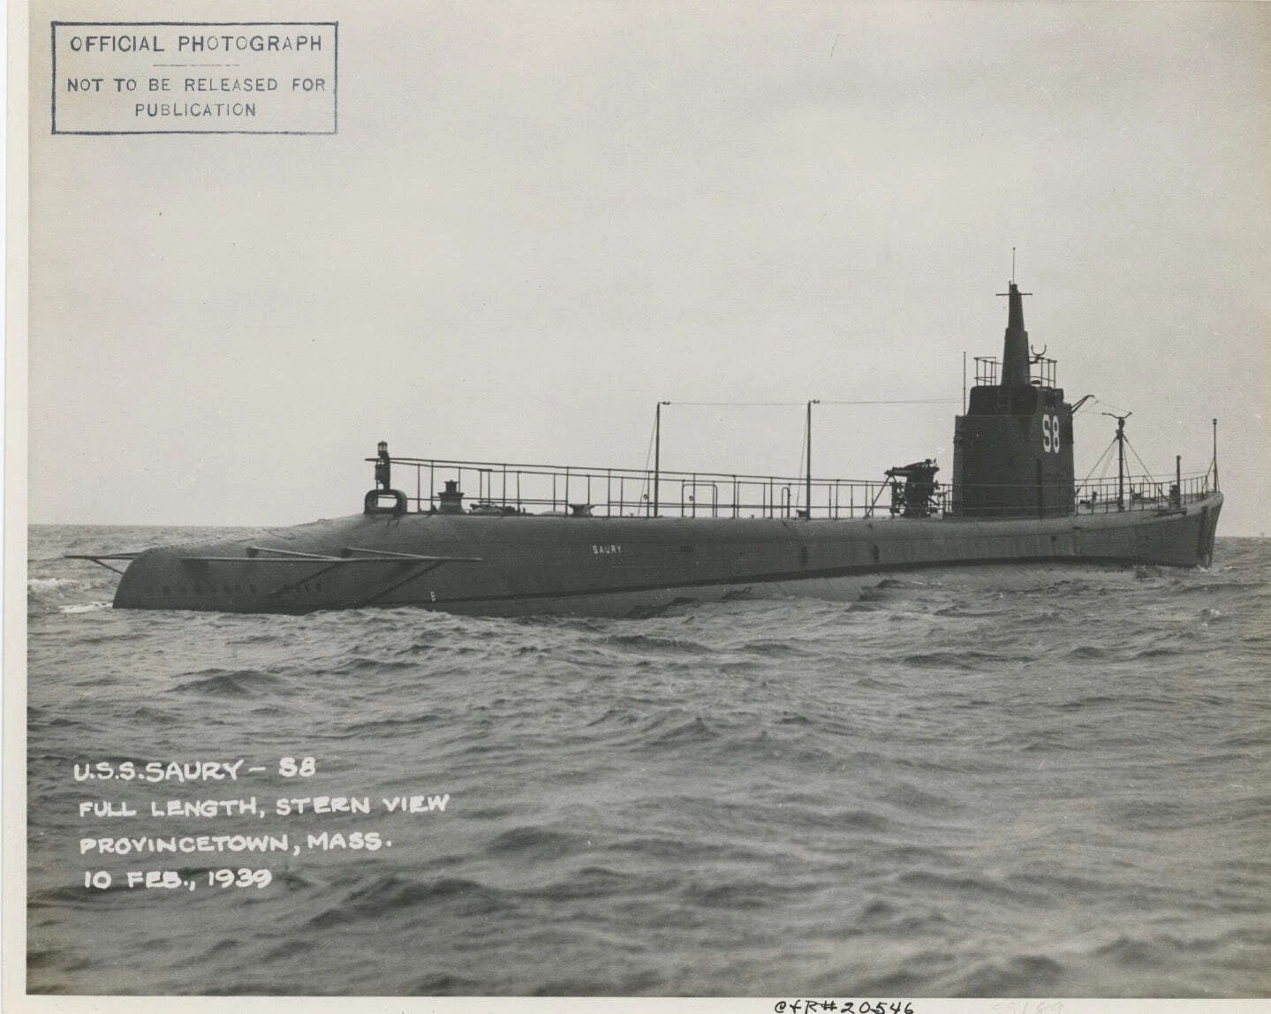
Mission Priority? Attack Japanese Merchants or Warships
USS Saury, <S8> SS-189 in February 1939
Notes:
What is alters our operations from the national strategy to a state of war? Is Mission Priority to sink Japanese Merchant Shipping or Japanese Warships? What do have to fight with?

Slide 7
Operational Challenges
Underway Endurance
Operational Range Limits
Minimal Dive Periods
Minimum Dive Depths
Refuel
Rearm
Repair
Crew Rest
Safe Havens
Variants
Multiple Ship Classes Equipment
Spare Parts Availability
Lack of RADAR
Periscope Heights & Heads
Engine Reliability
Torpedo Reliability
Torpedo Availability
Notes:
Torpedo Problems | Skipper Problems | Tactics/Techniques/Procedural Problems |

Slide 8
Operations 1942
Evacuation of the Philippines
Insurgency Support of the Philippines
Home Port Fremantle, Australia
Home Port Perth, Australia
Java Sea | Flores Sea | Banda Sea
Makassar Straight | Celebes Sea
Sulu Sea | West Philippine Sea
Timor Sea | Arafura Sea | Molucca Sea
Coral Sea | Solomon Sea
USS Sealion SS-195 Lost 10 DEC 1941
USS Shark SS-174 Lost 11 FEB 1942
USS Perch SS-176 Lost 03 MAR 1942
**USS Grunion SS-216 Lost 30 JUL 1942
Notes:
Concurrent Orders = War Patrol (Area Denial)(Evacuations & Supplies)& (ISR)
Grunion => Gato Class Submarine Commissioned Apr 1942 & Sunk July 1942 Circular Run Torpedo

Slide 9
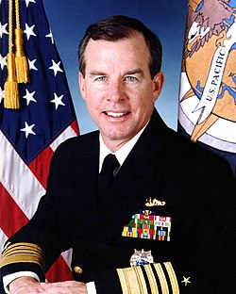
Operations 1942
IAW former CNO, ADM Thomas Fargo:
“The Submarine Force was unleashed upon Japanese Merchant Transports as their #1 targets.”
“Not one single torpedo was worth wasting on a destroyer escort!”

Slide 10
How Bad Were Torpedo Problems?
14,748 USN Torpedoes were fired during WWII in the Pacific, 55%-65% were duds!
The several Torpedo technical “Fixes” were not in place until 1944
Two US Submarines are known to have been lost due to circular runs by their own torpedoes.
Two other US Submarines are thought to have been lost, but not yet confirmed, by their own torpedoes
Friendly Fire & Accidents were the root cause of one-third (1/3), of the 52 Lost Boats from WWII
<17>

Slide 11
“Casualties of War”
By late 1944:
Most of the pre-war class submarines were sent to safer areas of the Pacific like the US West Coast and Pearl Harbor to perform tasks like training readiness missions
By War’s End:
Porpoise Class Lost 4 out of 10 boats
Salmon Class had no losses
Sargo Class Lost 4 out of 10 boats
Tambor Class Lost 7 out of 12 boats
Notes:
Of the thirty-two pre-war built submarines that were readily available at the start of the conflict, fifteen were lost, most by the end of 1943. Recognizing their limitations, the remaining boats were rotated out of the conflict areas and sent east to safe harbors for th3e remainder of the war.

Slide 12
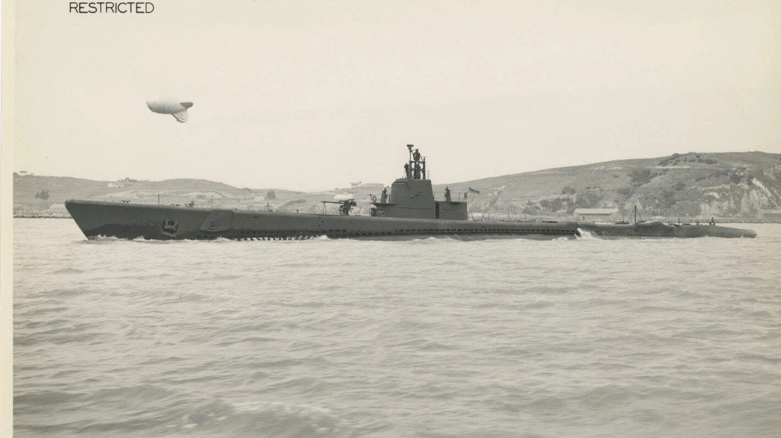
A-Typical Sargo Class Boat USS Saury, SS -189

